Slide 1
Pull:
Creating Software
People Can’t Live
Without

Slide 2
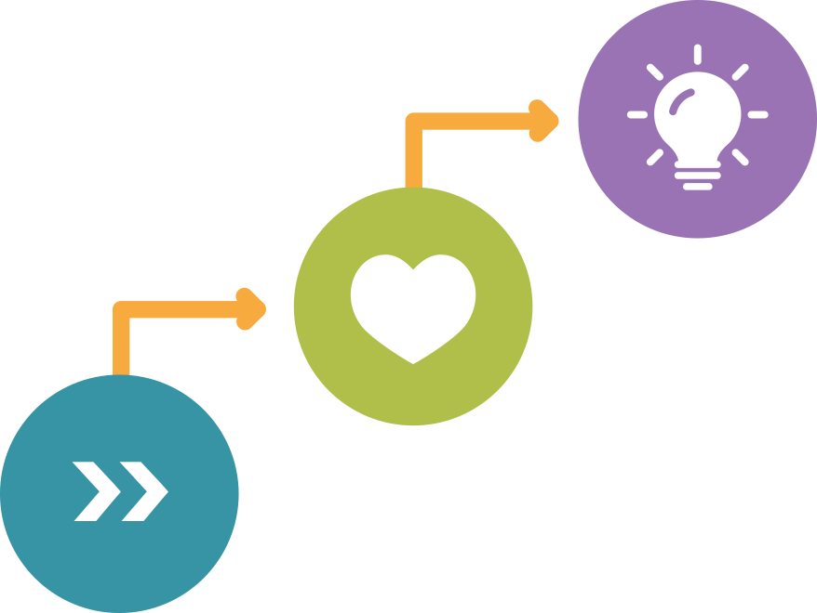
Your Customer’s
Journey.
The Mission
INSPIRE
TOUCH
MOVE

Slide 3
Your Customer’s
Journey.
Earning Advocates
ADVOCACY

Slide 4
Your Customer’s
Journey.
Loyalty is a Prerequisite
ADVOCACY
LOYALTY

Slide 5
Your Customer’s
Journey.
Trust is a Prerequisite
ADVOCACY
LOYALTY
TRUST

Slide 6
Dimensions
of Competition.
Choose two
QUALITY
SPEED
PRICE

Slide 7
Dimensions
of Competition.
Social Media?
QUALITY

Slide 8
Dimensions
of Competition.
Google in your pocket?
SPEED

Slide 9
Dimensions
of Competition.
Race to zero?
PRICE

Slide 10
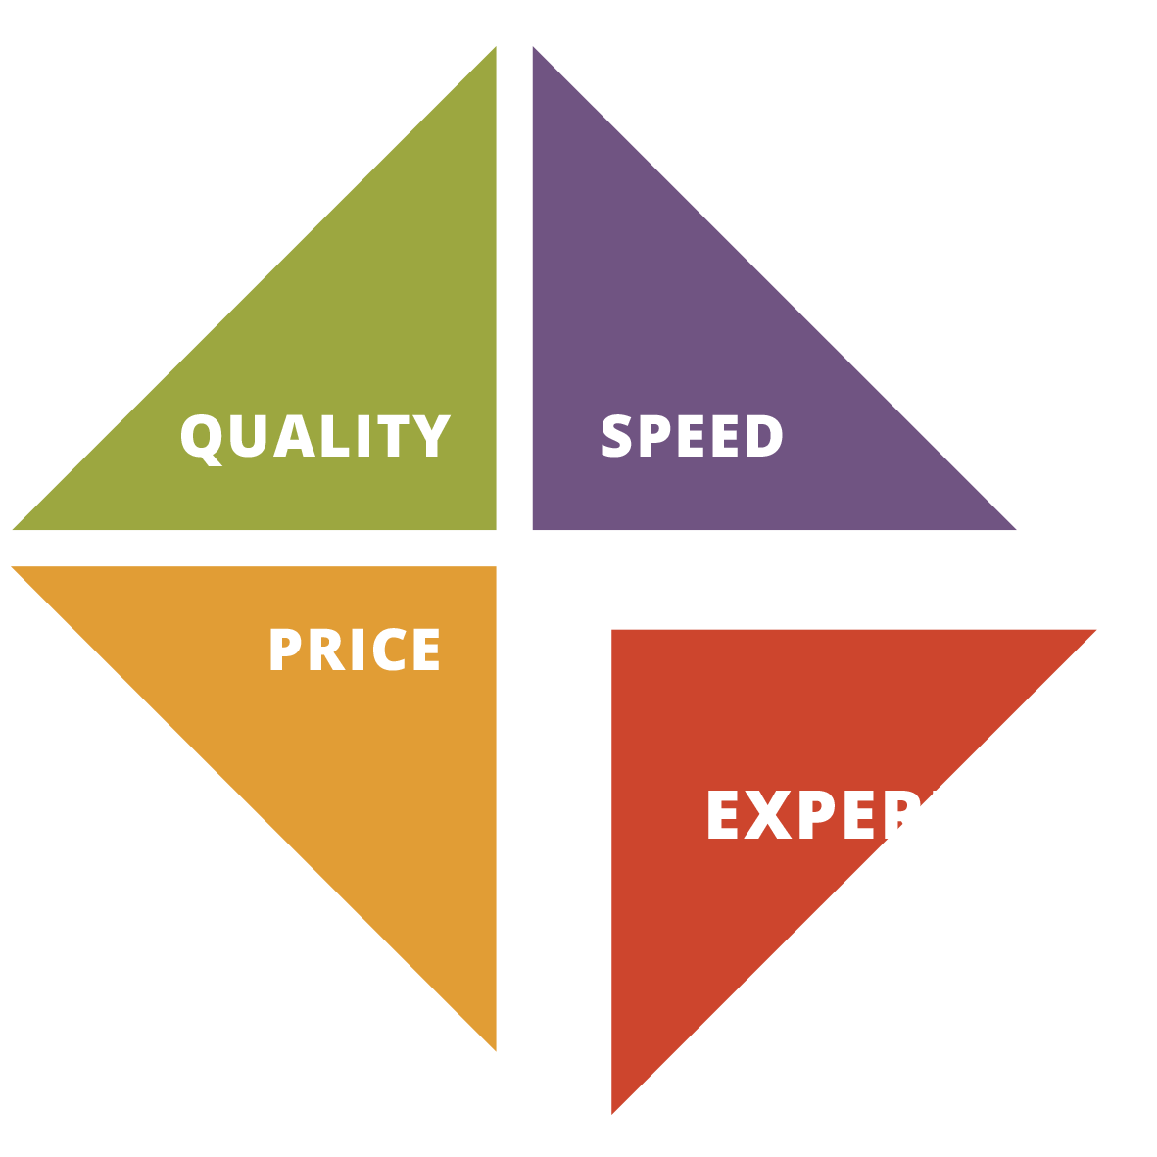
The 4th Dimension
of Competition.
Experience is the differentiator with the most transformative and disruptive power.

Slide 11
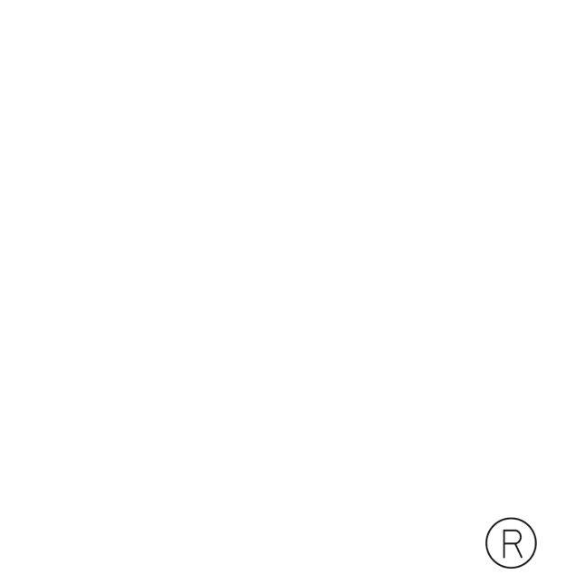

Slide 12
Your Customer’s
Journey.
Earn Advocates
INSPIRE
TOUCH
MOVE

Slide 13
Trust.
Moving customers
into a trust relationship

Slide 14
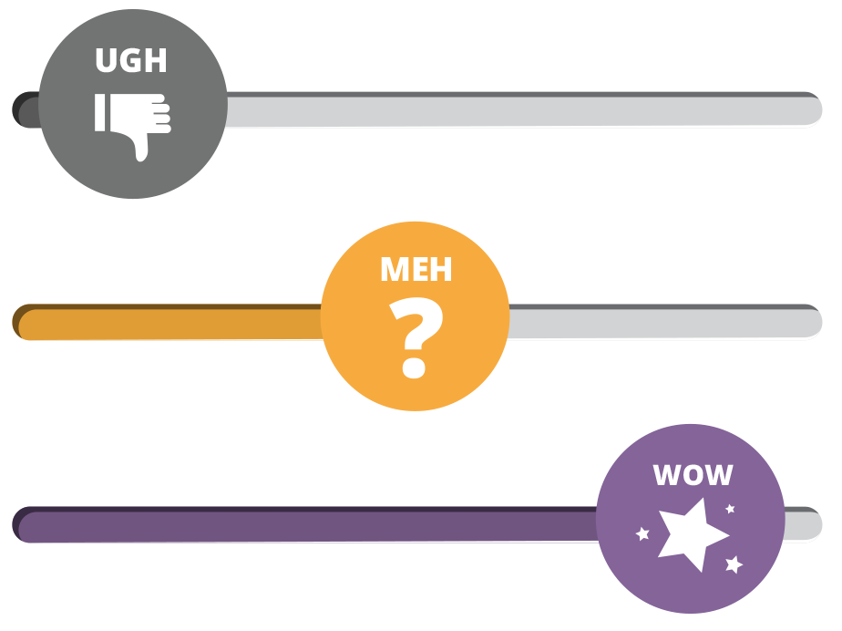
Trust.
Starts with
First Impressions

Slide 15
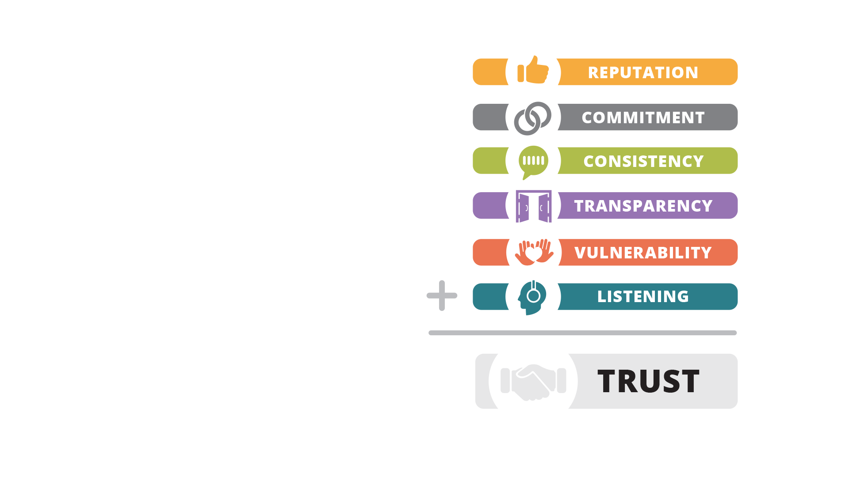
Trust.
Is tangible and actionable

Slide 16
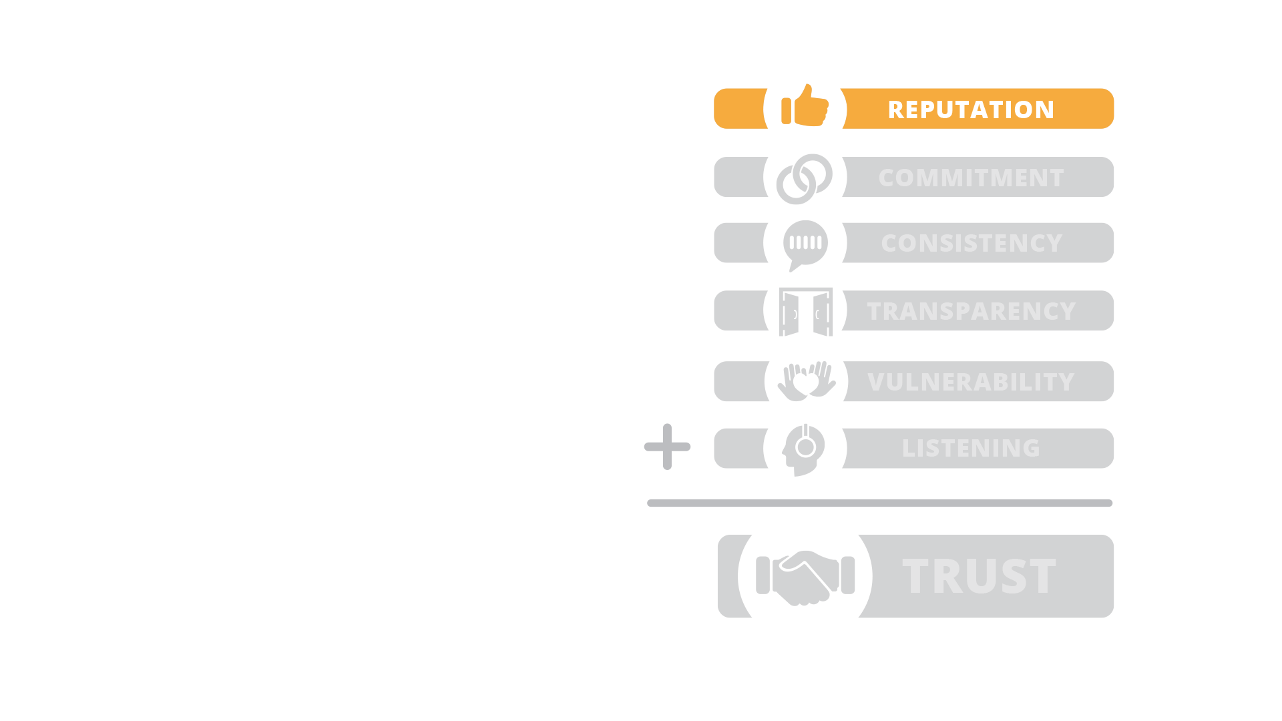
Reputation.
Show, don‘t tell
- Testimonials
- Case Studies
- Awards
- Social Proof

Slide 17
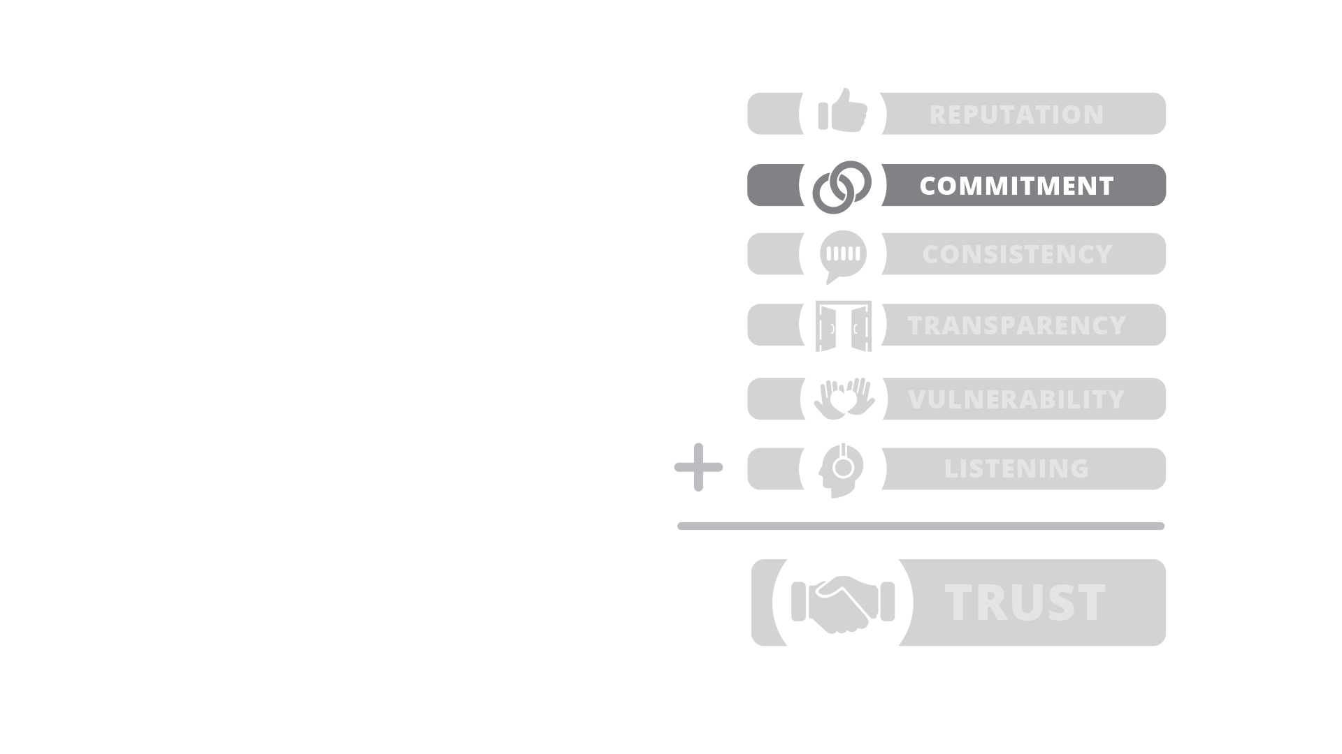
Commitment.
Use strong language
- Small promises
- Bold commitments
- Talk about It
- Language of Commitment

Slide 18
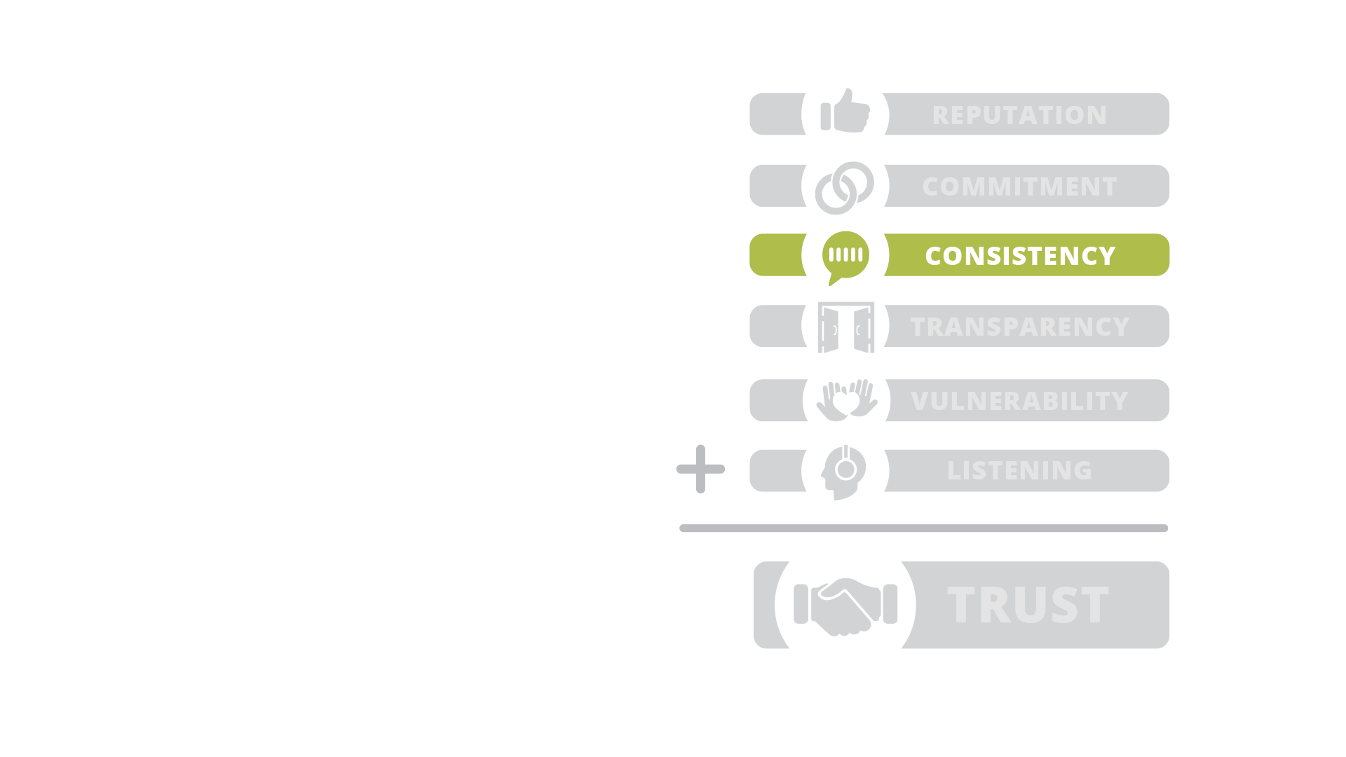
Consistency.
Be Trustworthy
- Look & Feel (UI Kit)
- Language & Lexicon
- Imagery & Voice
- Clarity & Simplicity

Slide 19
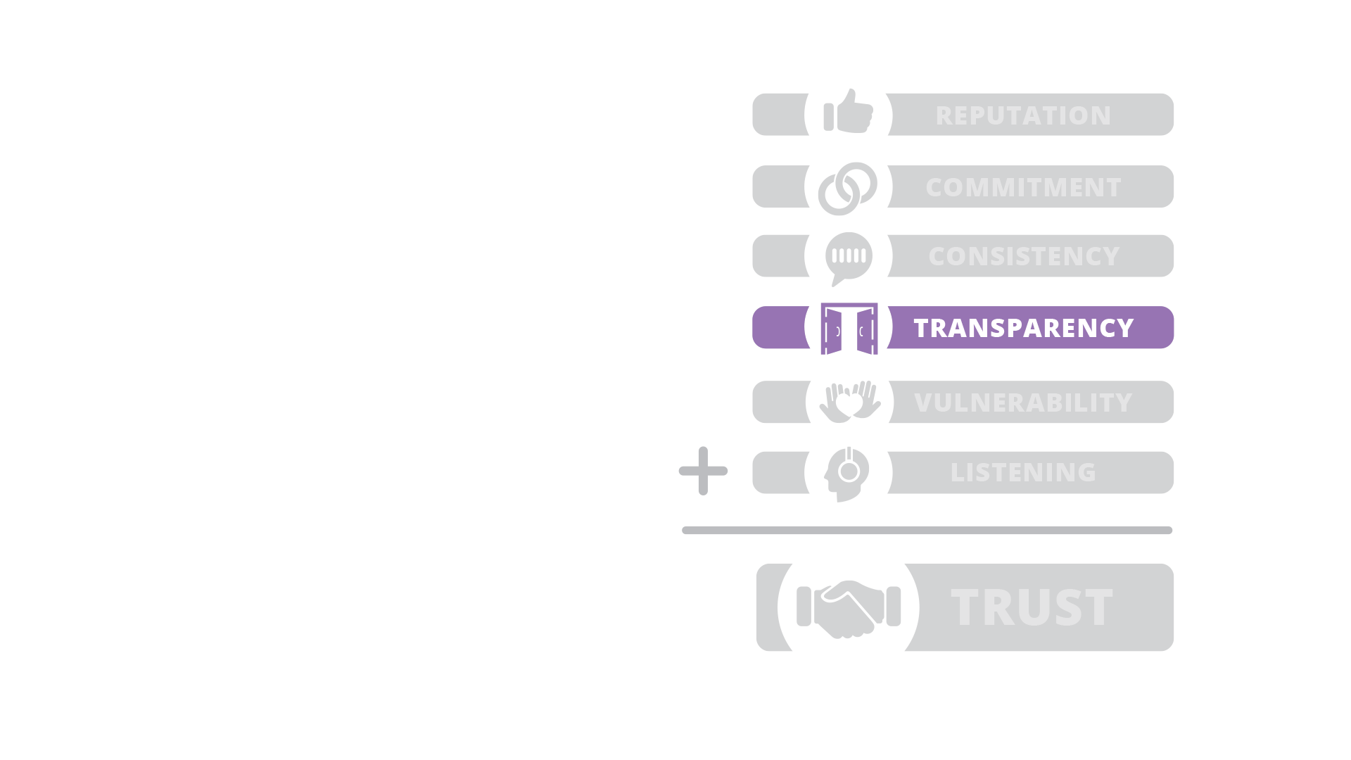
Transparency.
Share more than you think you should
- Knowledge
- Techniques & process
- Data & insights
- Vulnerabilities

Slide 20
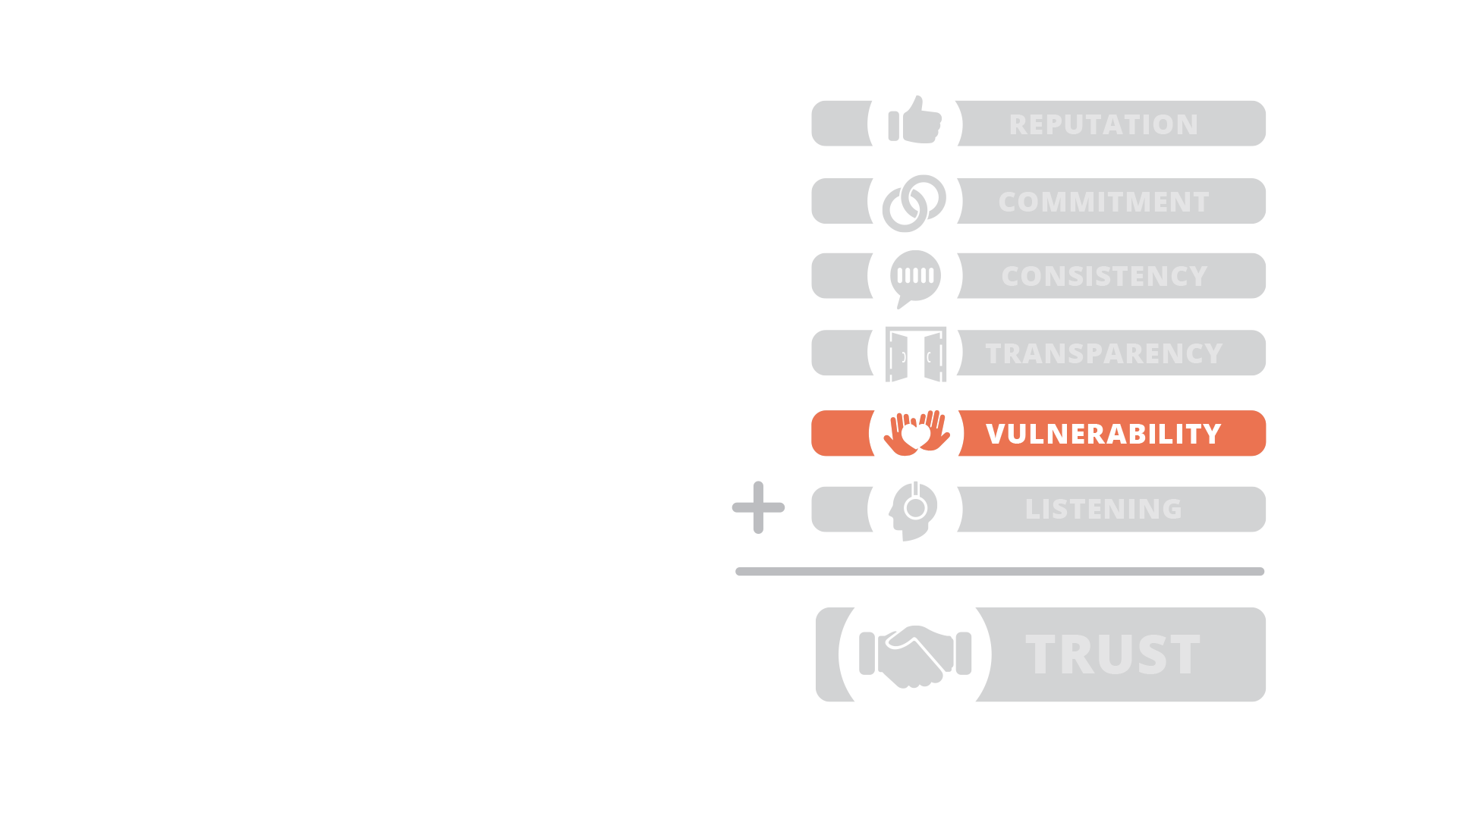
Vulnerability.
Be more human
- Show you are imperfect
- Demonstrate how you respond to disruptions

Slide 21
“People will always choose imperfection with integrity over a perfect facade.”

Slide 22
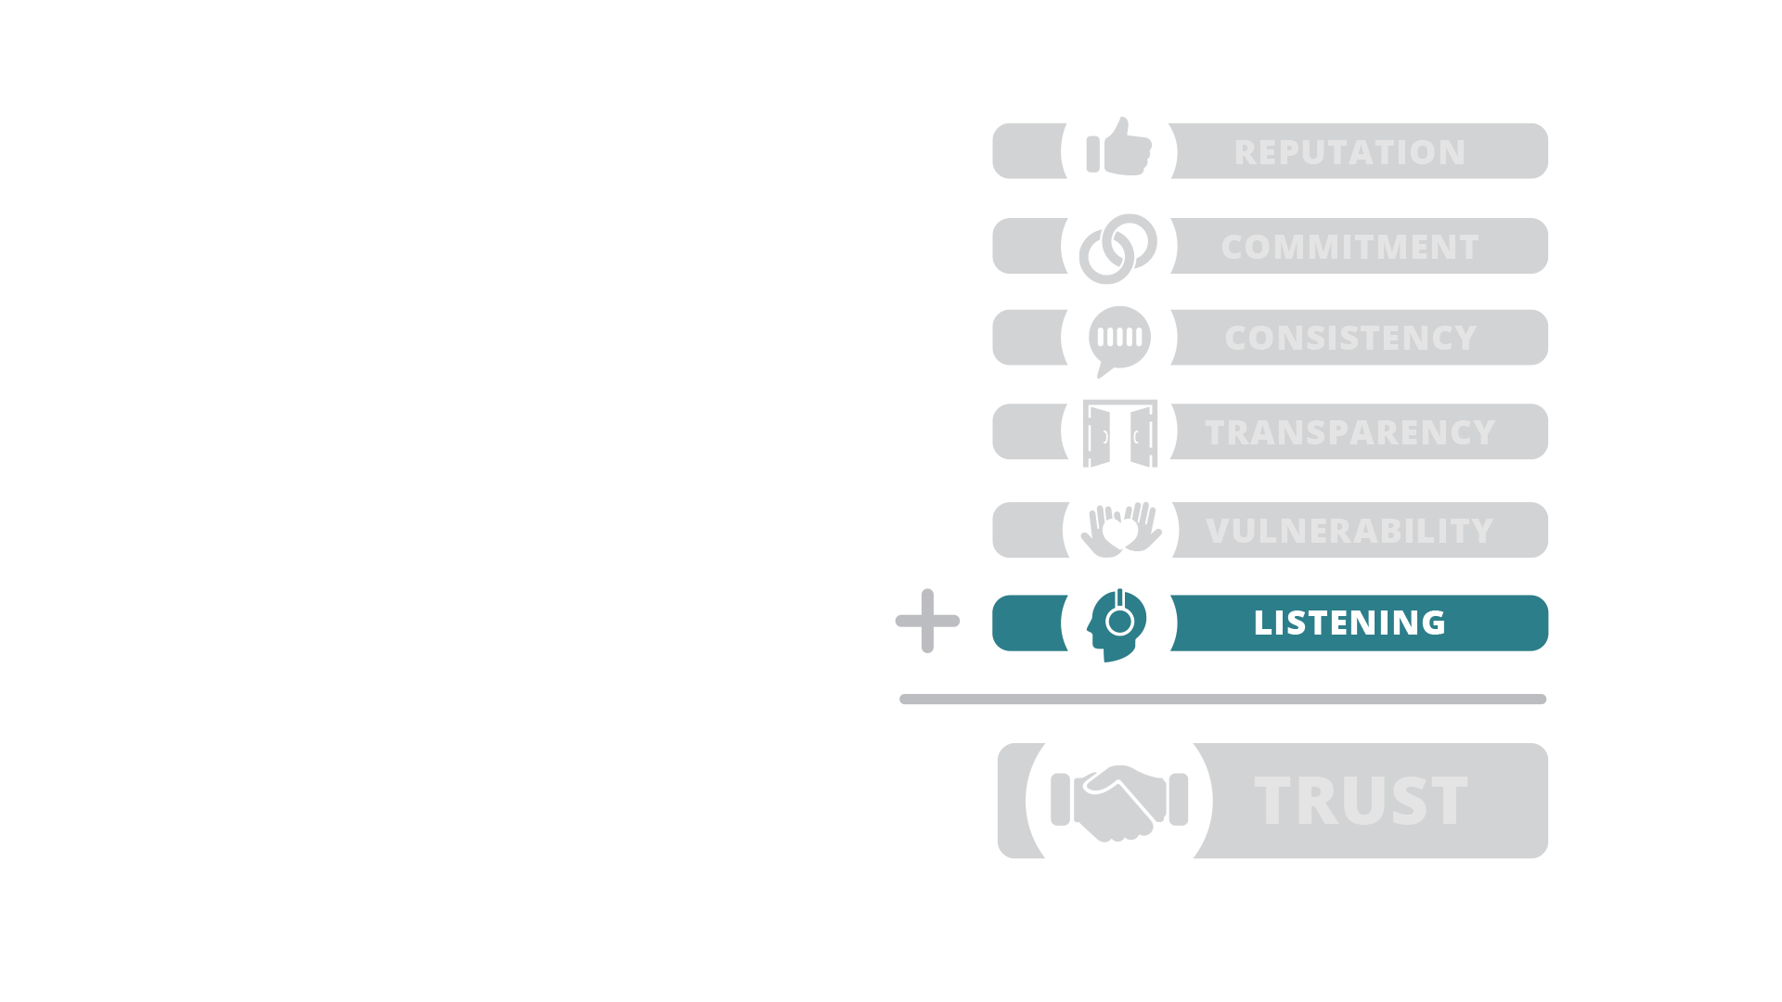
Listening.
Listen with the intent to understand
- Understand concerns
- Respond with passion
- Honor feedback
- Acknowledge

Slide 23
Trust.
The purposeful development of trust

Slide 24
“Trust is a pragmatic, tangible, actionable asset that you can create - much faster than you probably think possible.”
- Stephen Covey

Slide 25
Loyalty.
Touch your customers with technology to generate sustainable loyalty

Slide 26
The 4 factors
of Customer
Loyalty.
Build Trust
Over Time
Human
Touch
Handle Service
Disruptions
Reduce
Effort

Slide 27
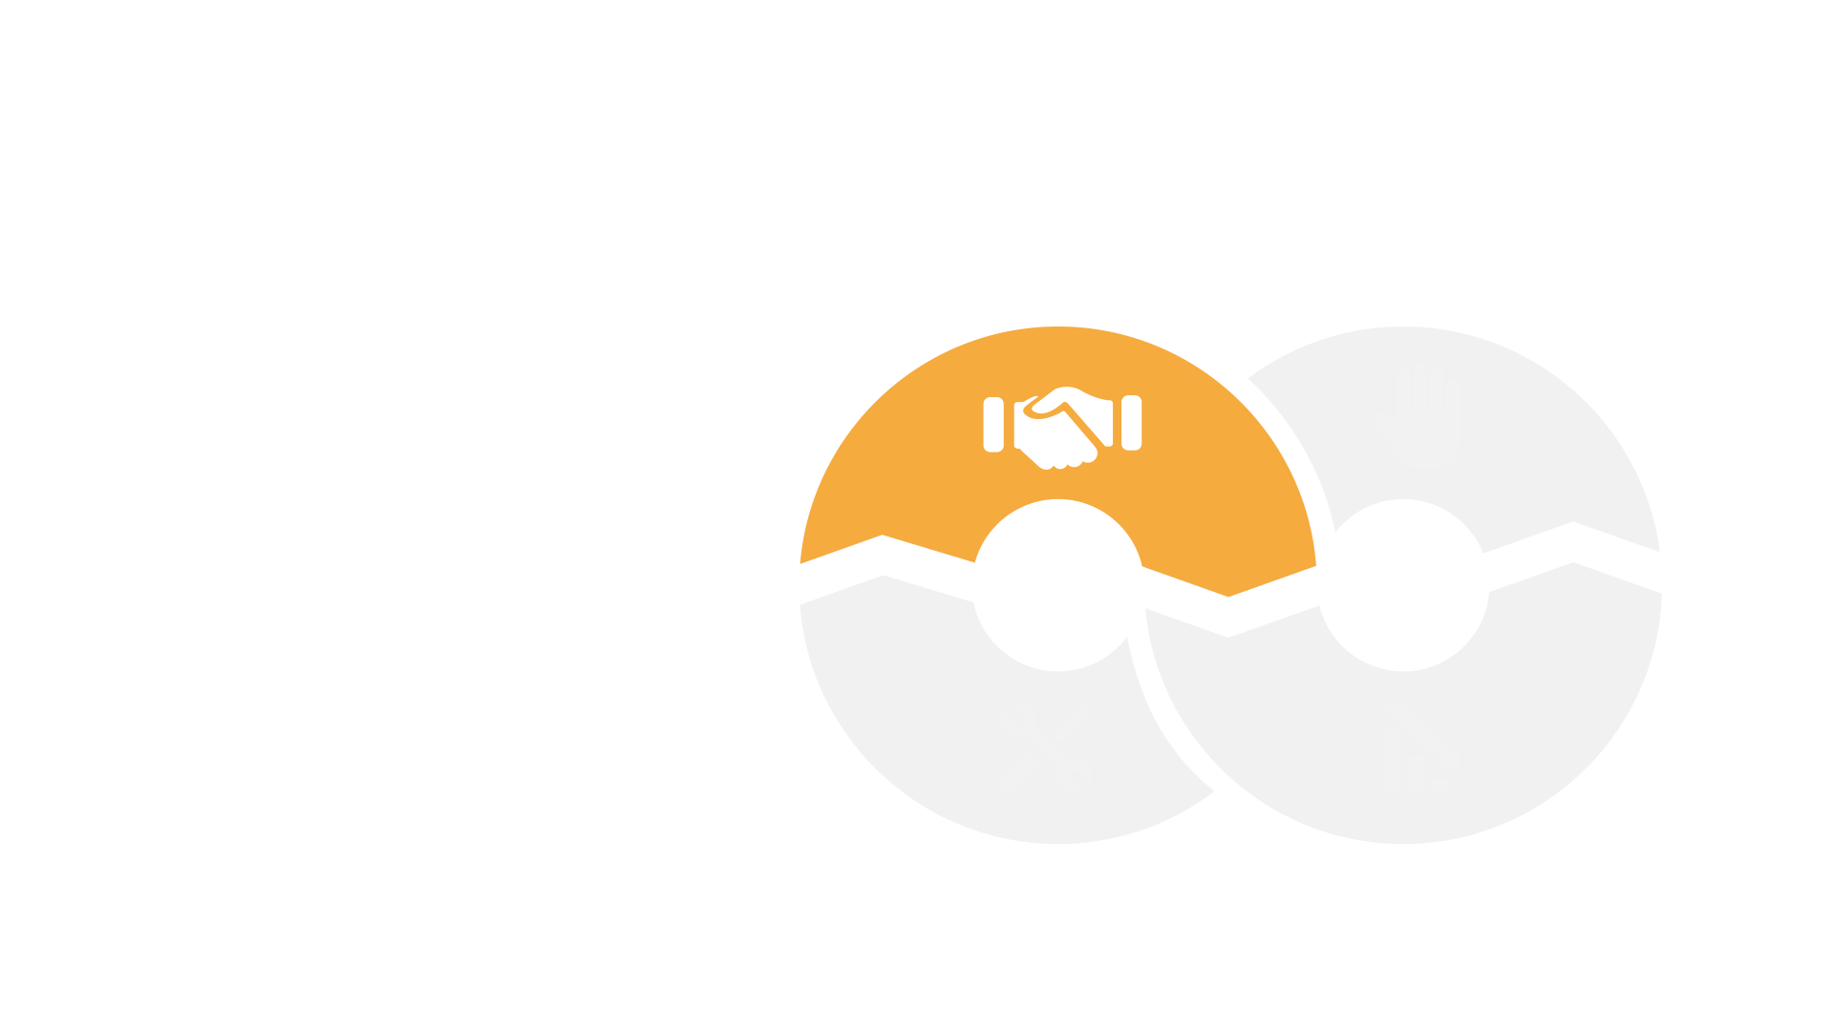
Build Trust
Over Time.
Build Trust
Over Time
Be what you say you are
Add Value
Be Trustworthy
Be a Rock

Slide 28
Reduce Effort.
Make it easy
- Reduce & Simplify
- Reuse
- Predict
Reduce
Effort

Slide 29
Provide A Human Touch.
People Relate to People.
Human
Touch
- Human Language
- Use Faces
- Pick Up The Phone
- Personalize

Slide 30
Handle Service Disruptions.
Manage Anxiety.
- Acknowledge
- Make Commitments
- Empower Service
- Over-Communicate
Handle Service
Disruptions

Slide 31
The 4 factors
of Customer
Loyalty.
Build Trust
Over Time
Human
Touch
Handle Service
Disruptions
Reduce
Effort

Slide 32
“People will forget what you said, people will forget what you did, but people will never forget how you made them feel.”
- Maya Angelou.

Slide 33
Inspire.
ROI of Brand Advocates
- Forgiveness
- Source of evidence
- Defenders of your brand
- Self-Identified Community
- Promote your brand

Slide 34
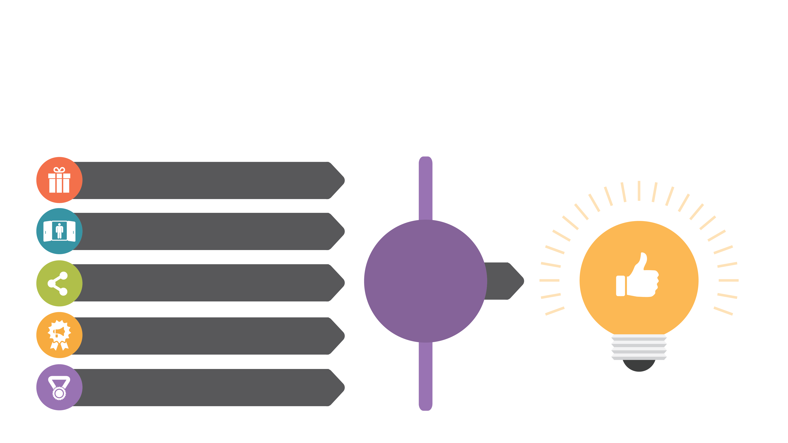
Advocacy.
Triggering Advocacy
Reward them
Invite them in
Make it easy to share
ADVOCACY
THRESHOLD
Honor their feedback
Recognize them

Slide 35
Advocacy.
Give them something unique
Reward them
Surprise them
Give them something to remember
Give them something they can only get from you

Slide 36
Advocacy.
Make them feel like they are insiders
Reward them
Share with them
Make them a part of your community
Make them feel a part of something bigger
Invite them in

Slide 37
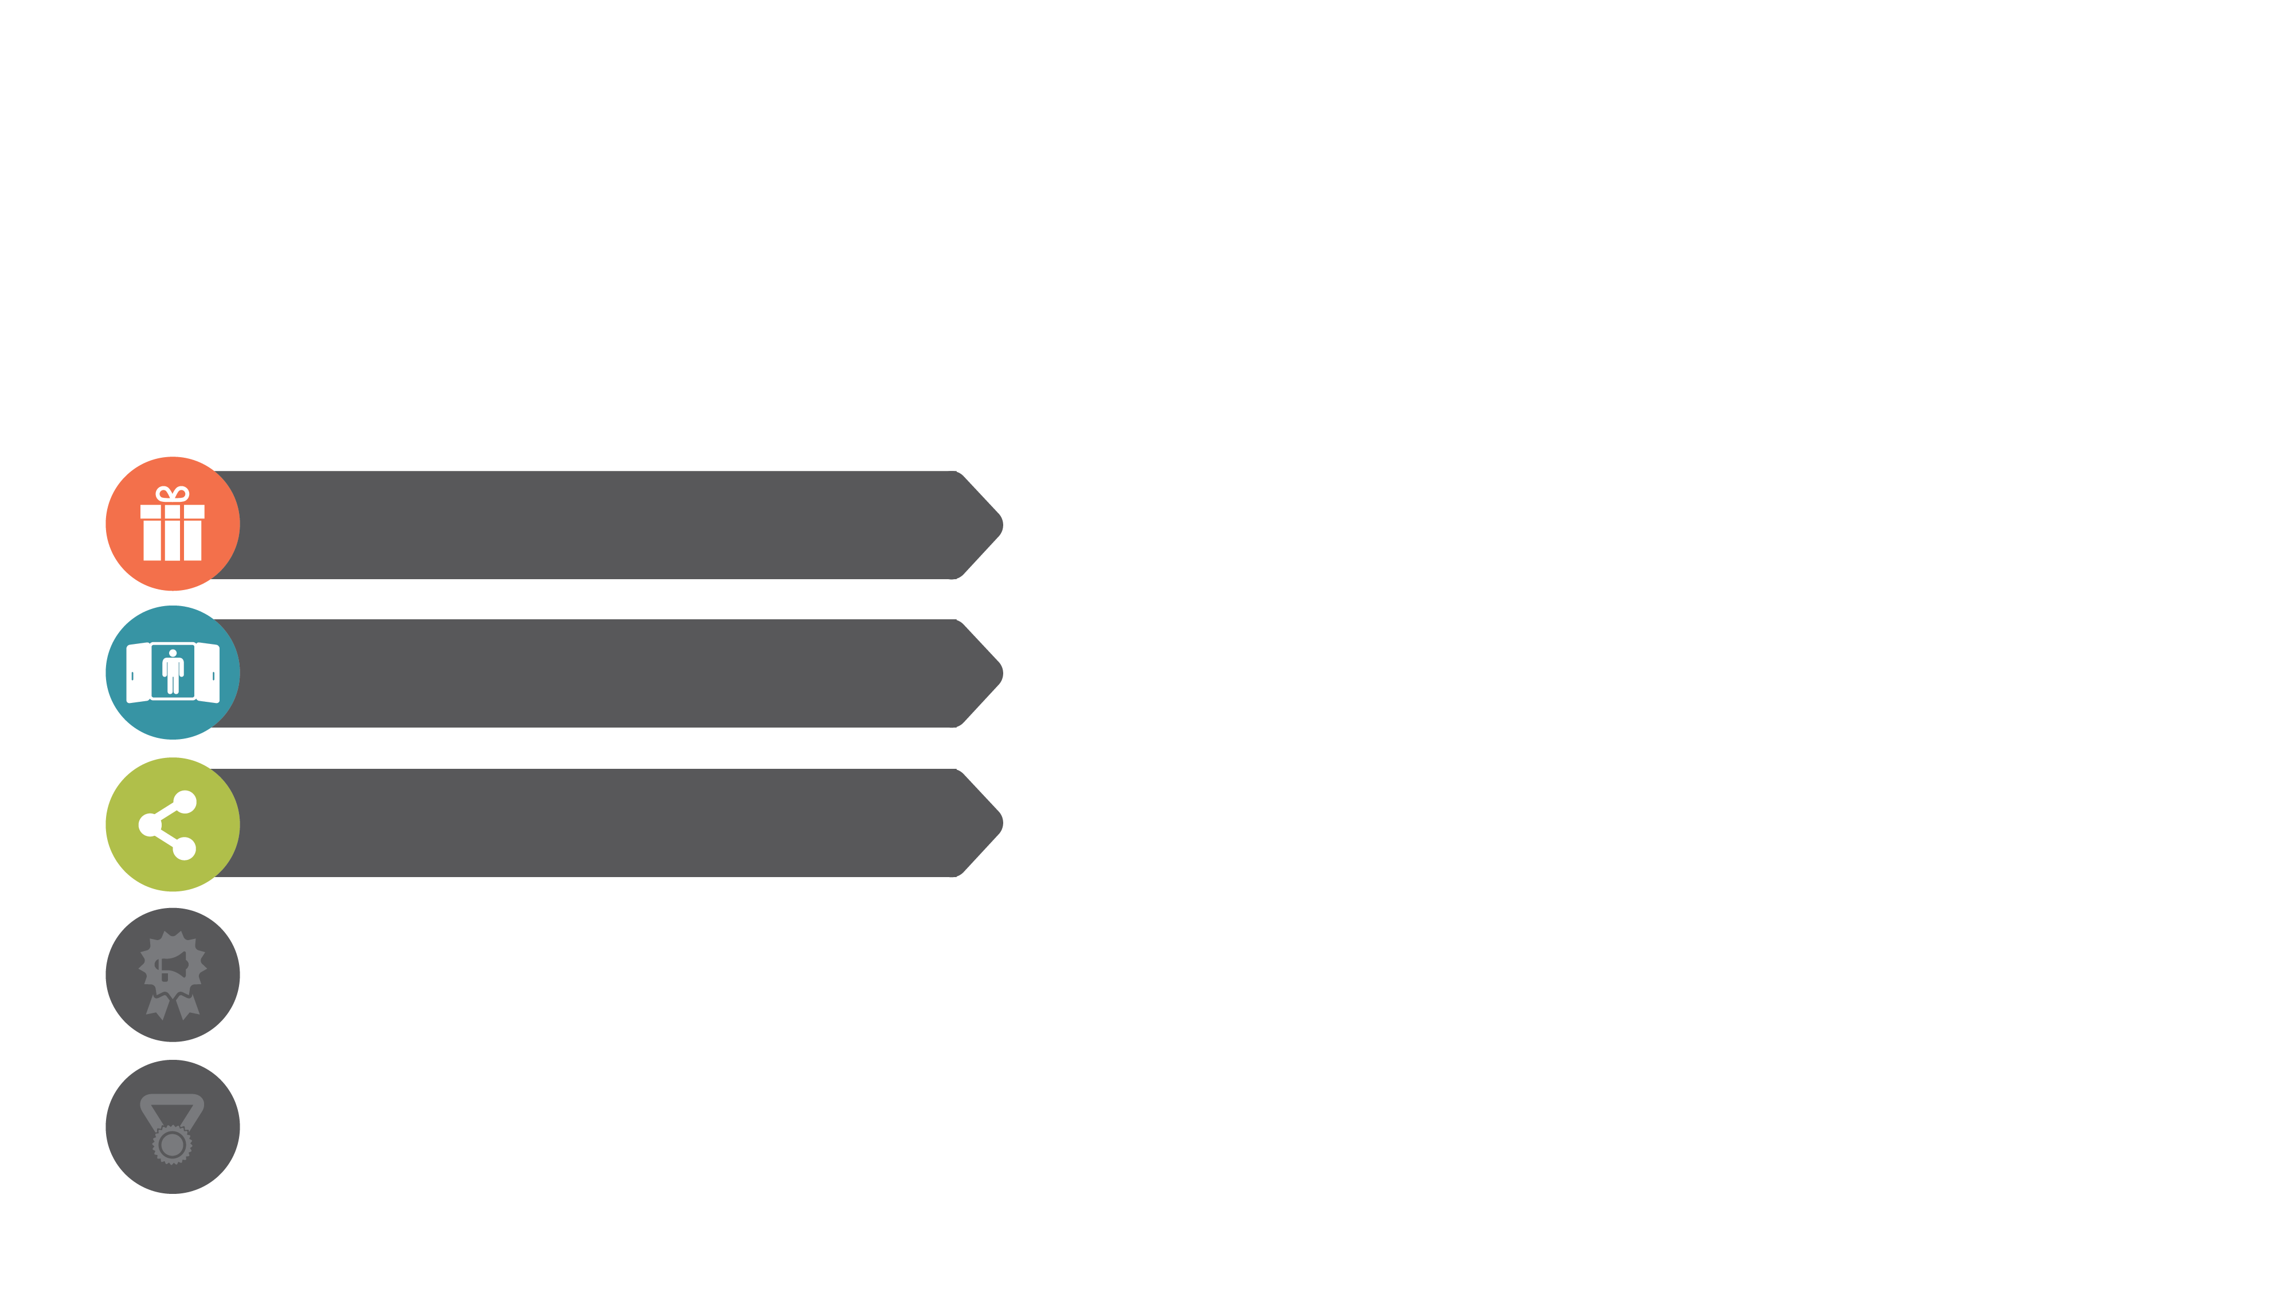
Advocacy.
Do the work for them
Reward them
Provide encouragemen
to share
Help them tell a story
Create simple tools that facilitate sharing
Invite them in
Make it easy to share

Slide 38
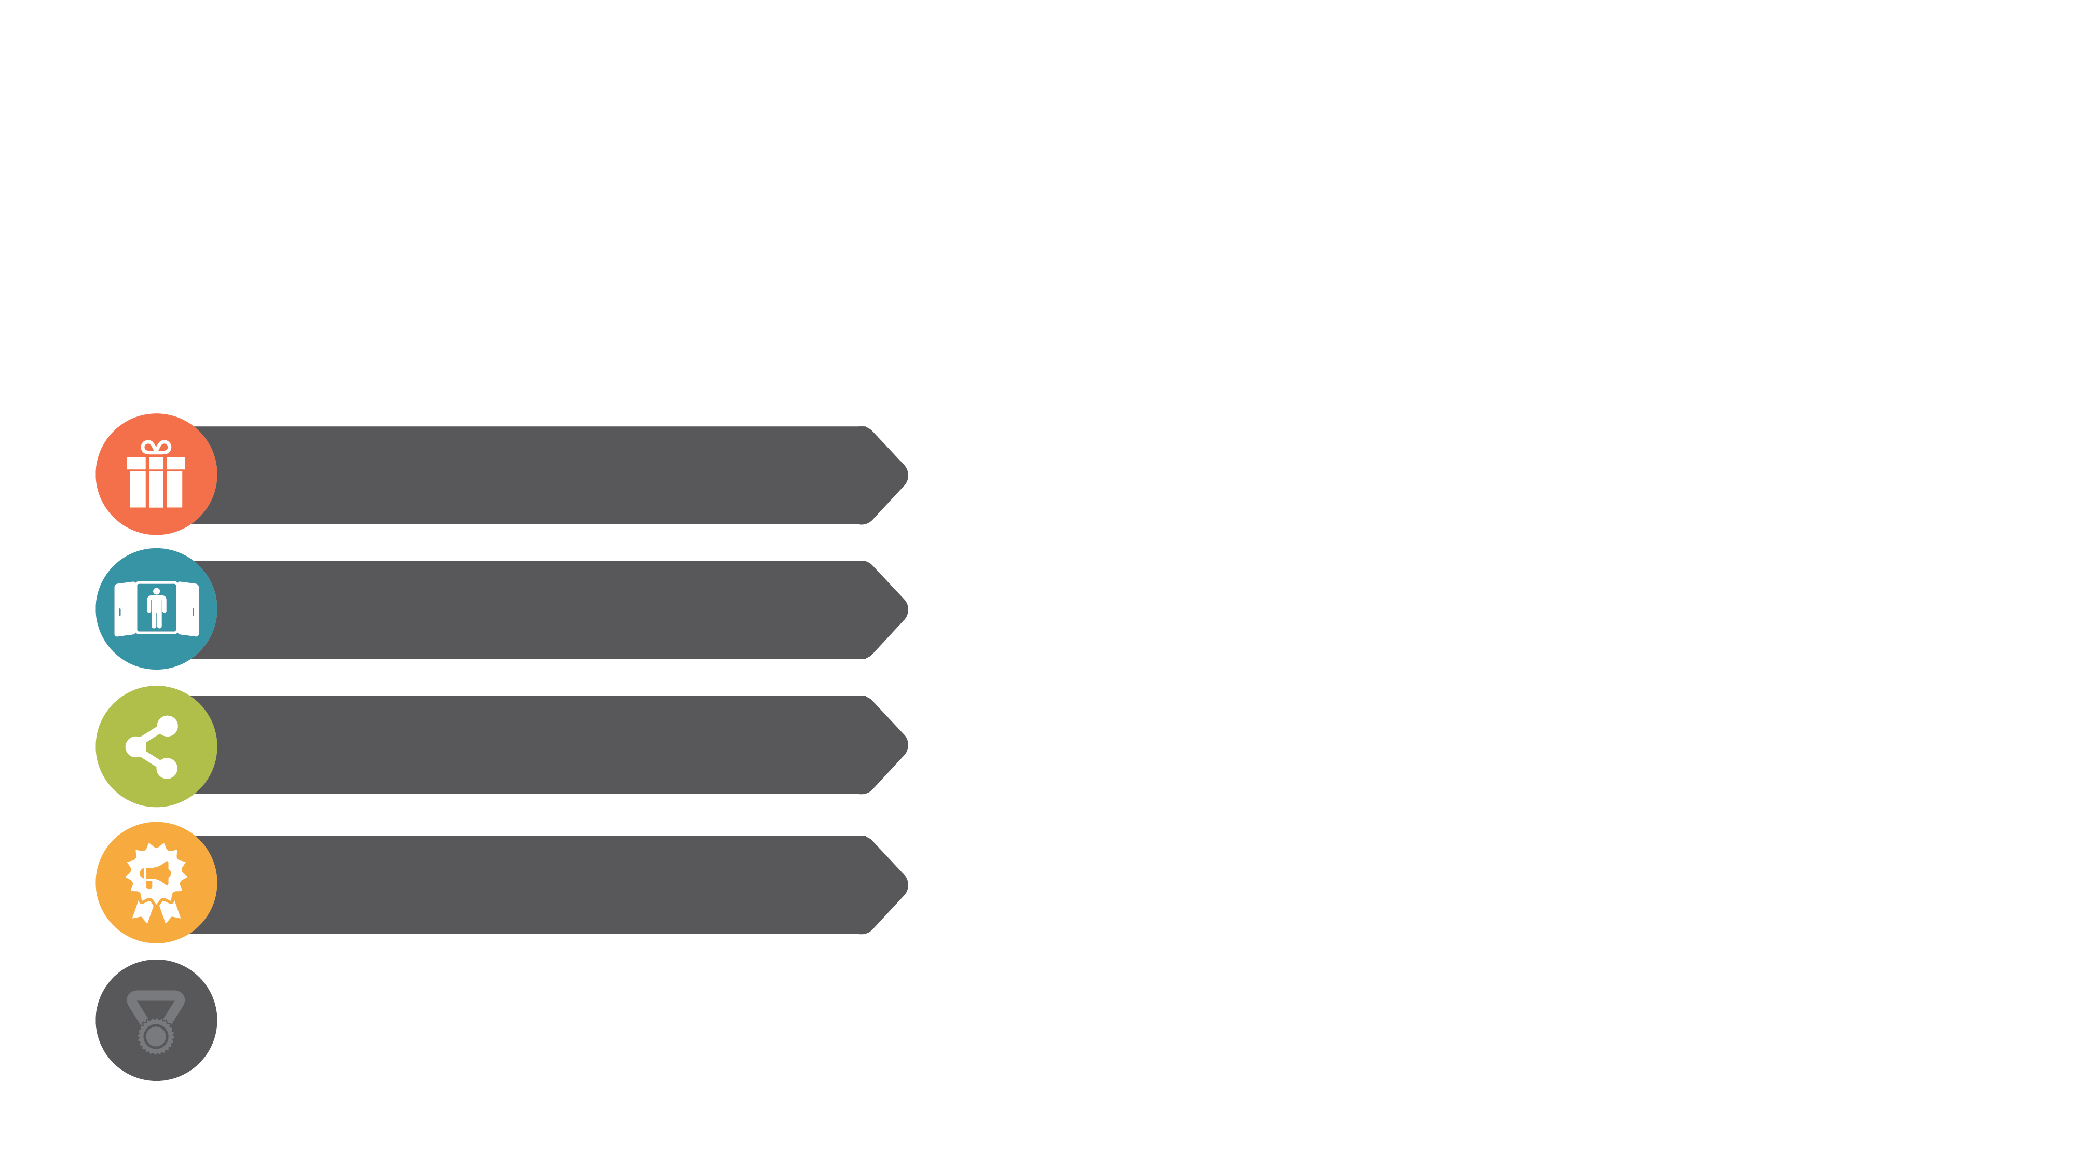
Advocacy.
Feedback is gold
Reward them
Recognize Feedback
Use their language in your responses
Communicate, more than once, when their feedback is considered
Invite them in
Make it easy to share
Honor their feedback

Slide 39
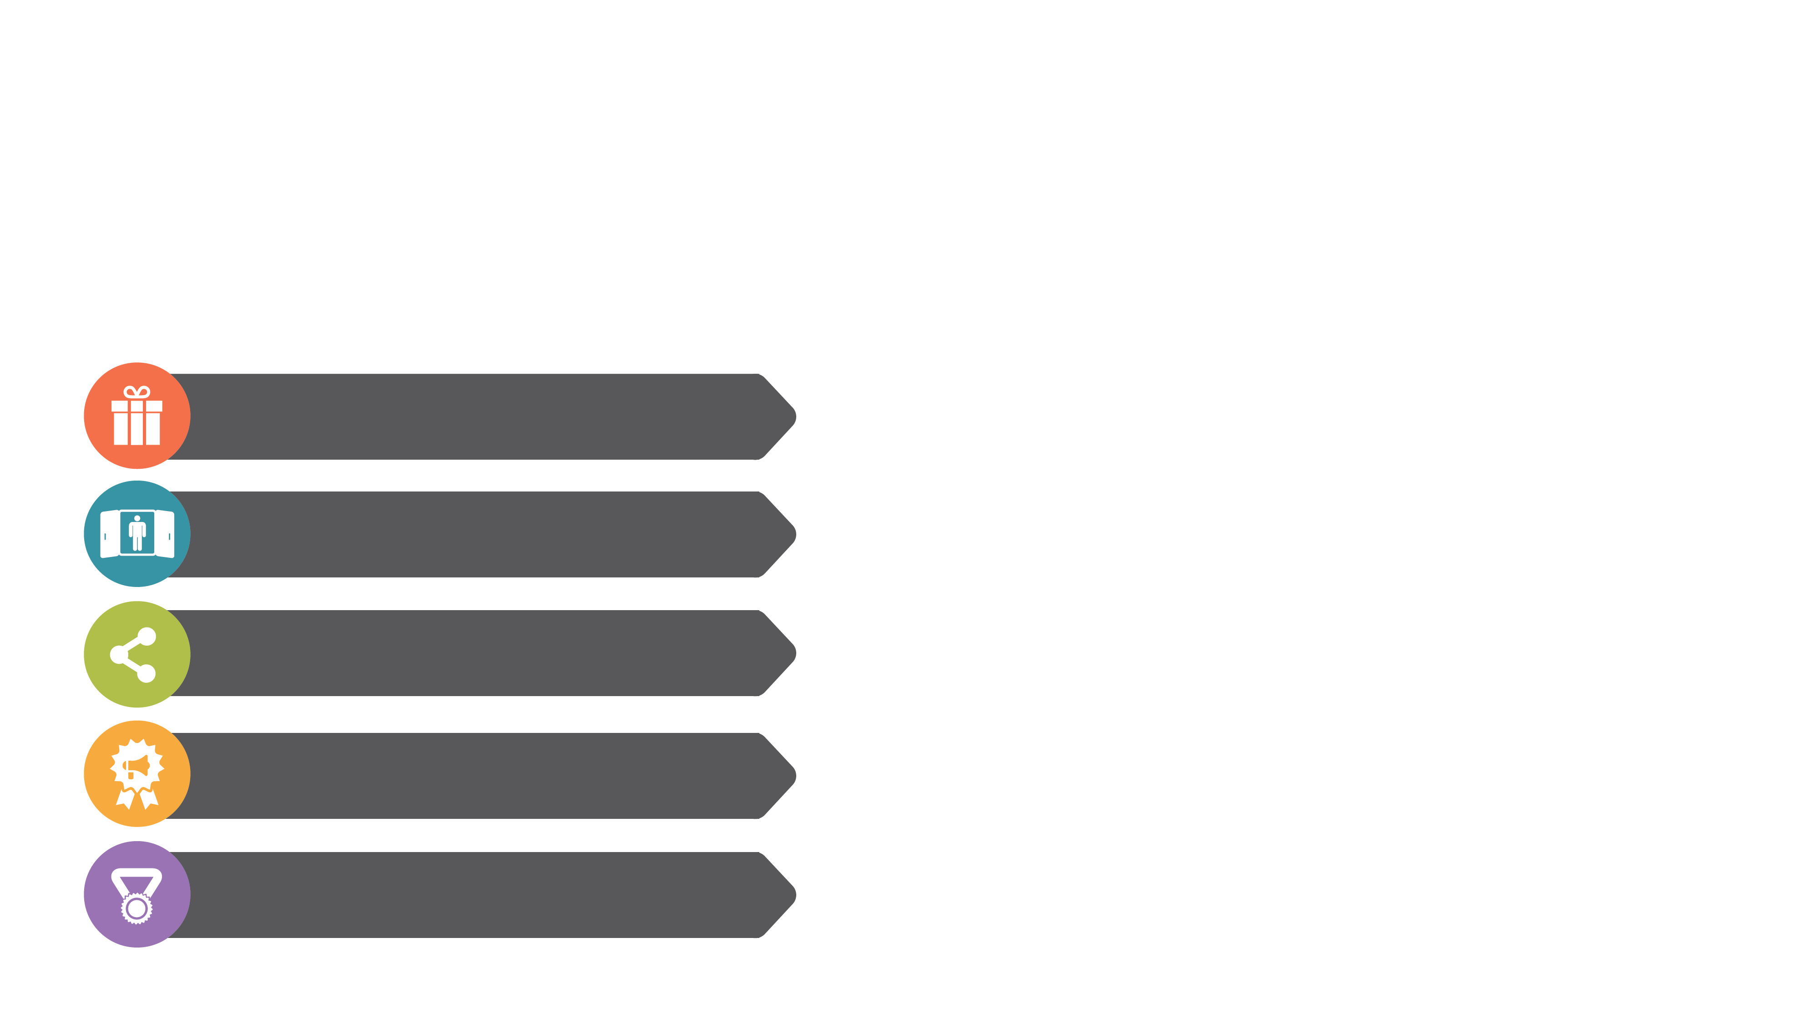
Advocacy.
Make them feel special
Reward them
Demonstrate their accomplishments
Give them something to brag about
Use their name
Invite them in
Make it easy to share
Honor their feedback
Recognize them

Slide 40
Advocacy.
Trigger Advocacy
Reward them
Invite them in
Make it easy to share
ADVOCACY
THRESHOLD
Honor their feedback
Recognize them

Slide 41
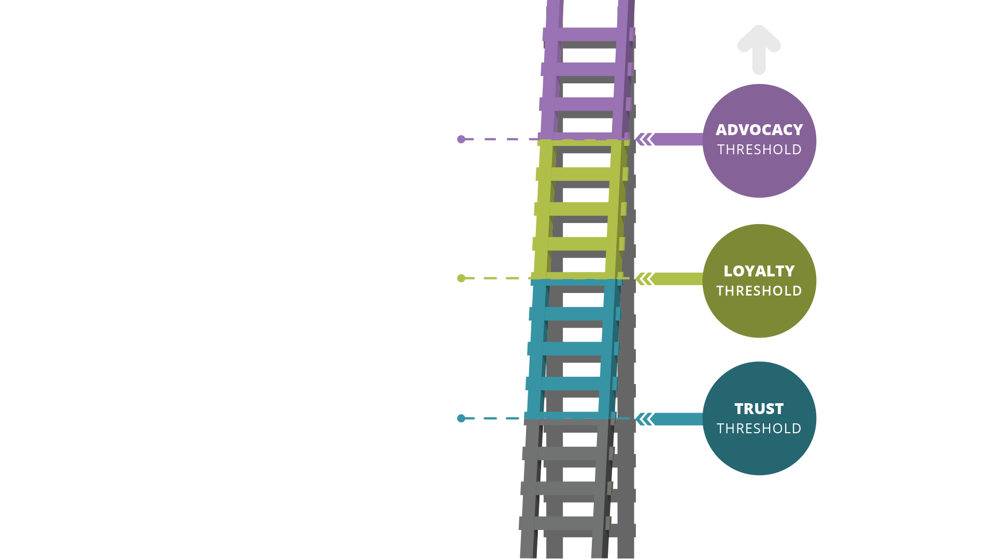
The Loyalty
Ladder.
The Micro Experiences
That Impact Your Brand

Slide 42
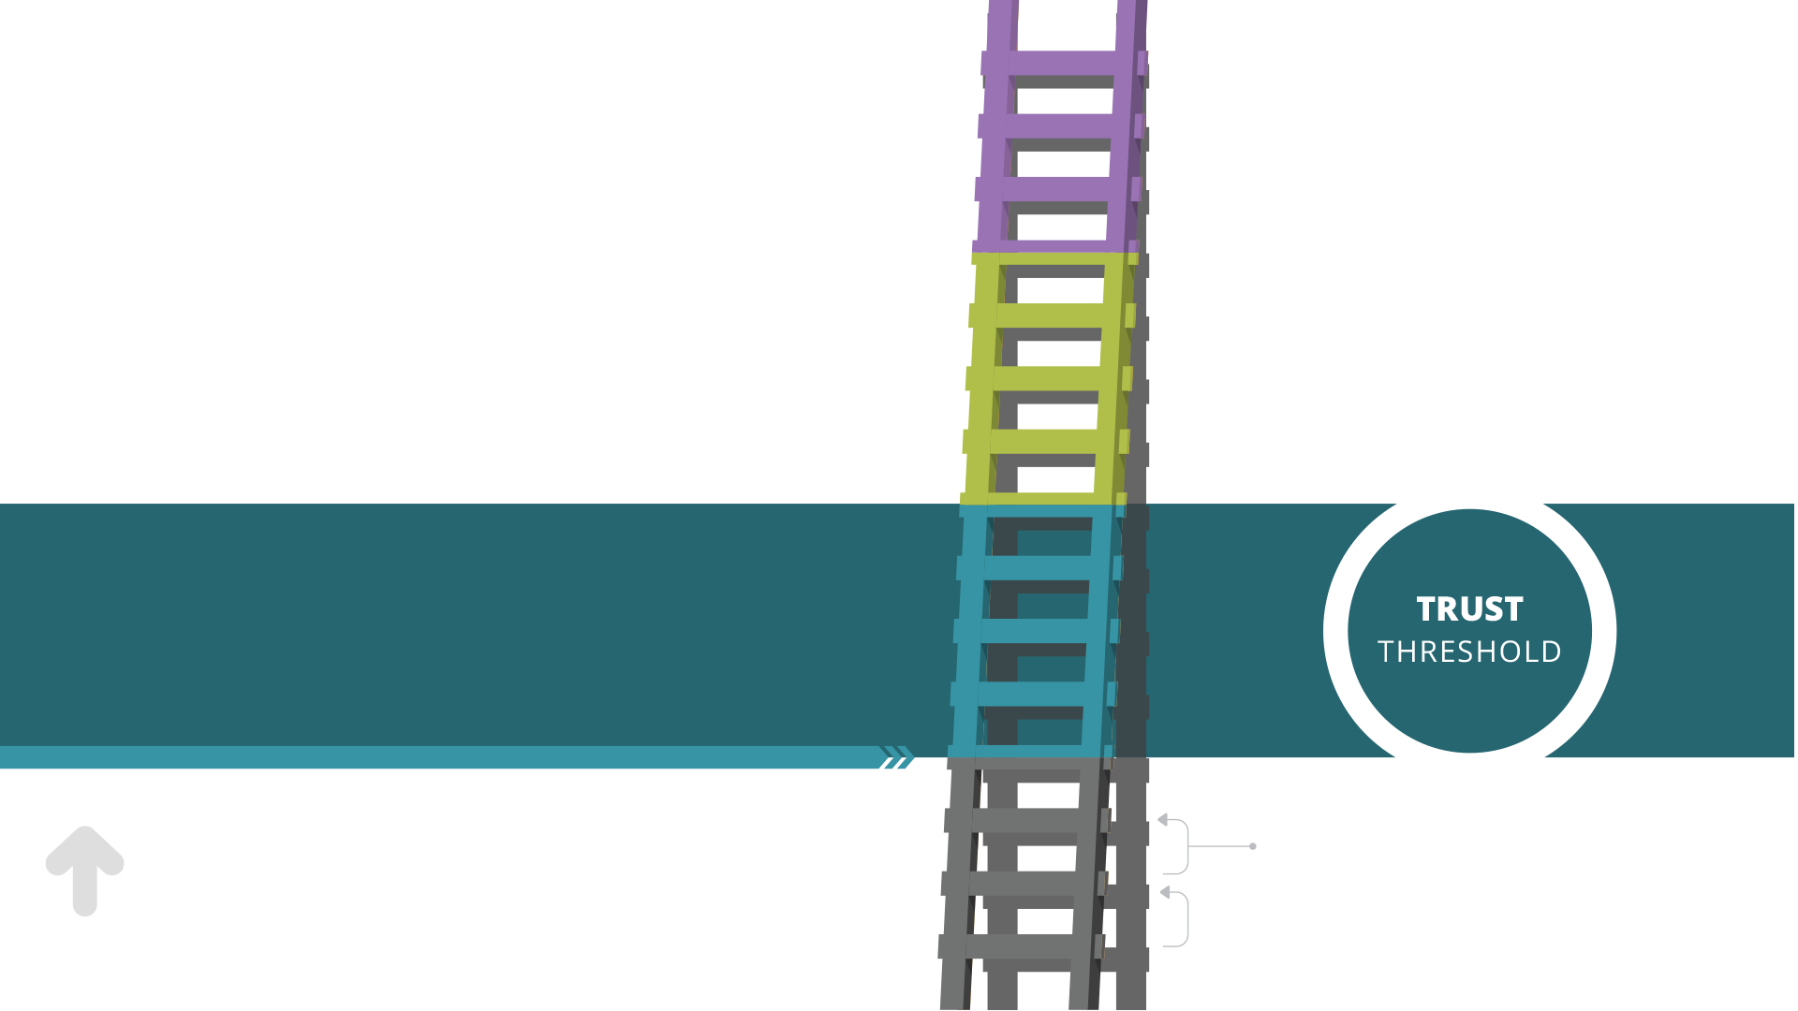
This is the point where you’ve earned enough trust for your customers to make their first
personal investment of time, information
or money in your firm.
Upward Movement.

Slide 43
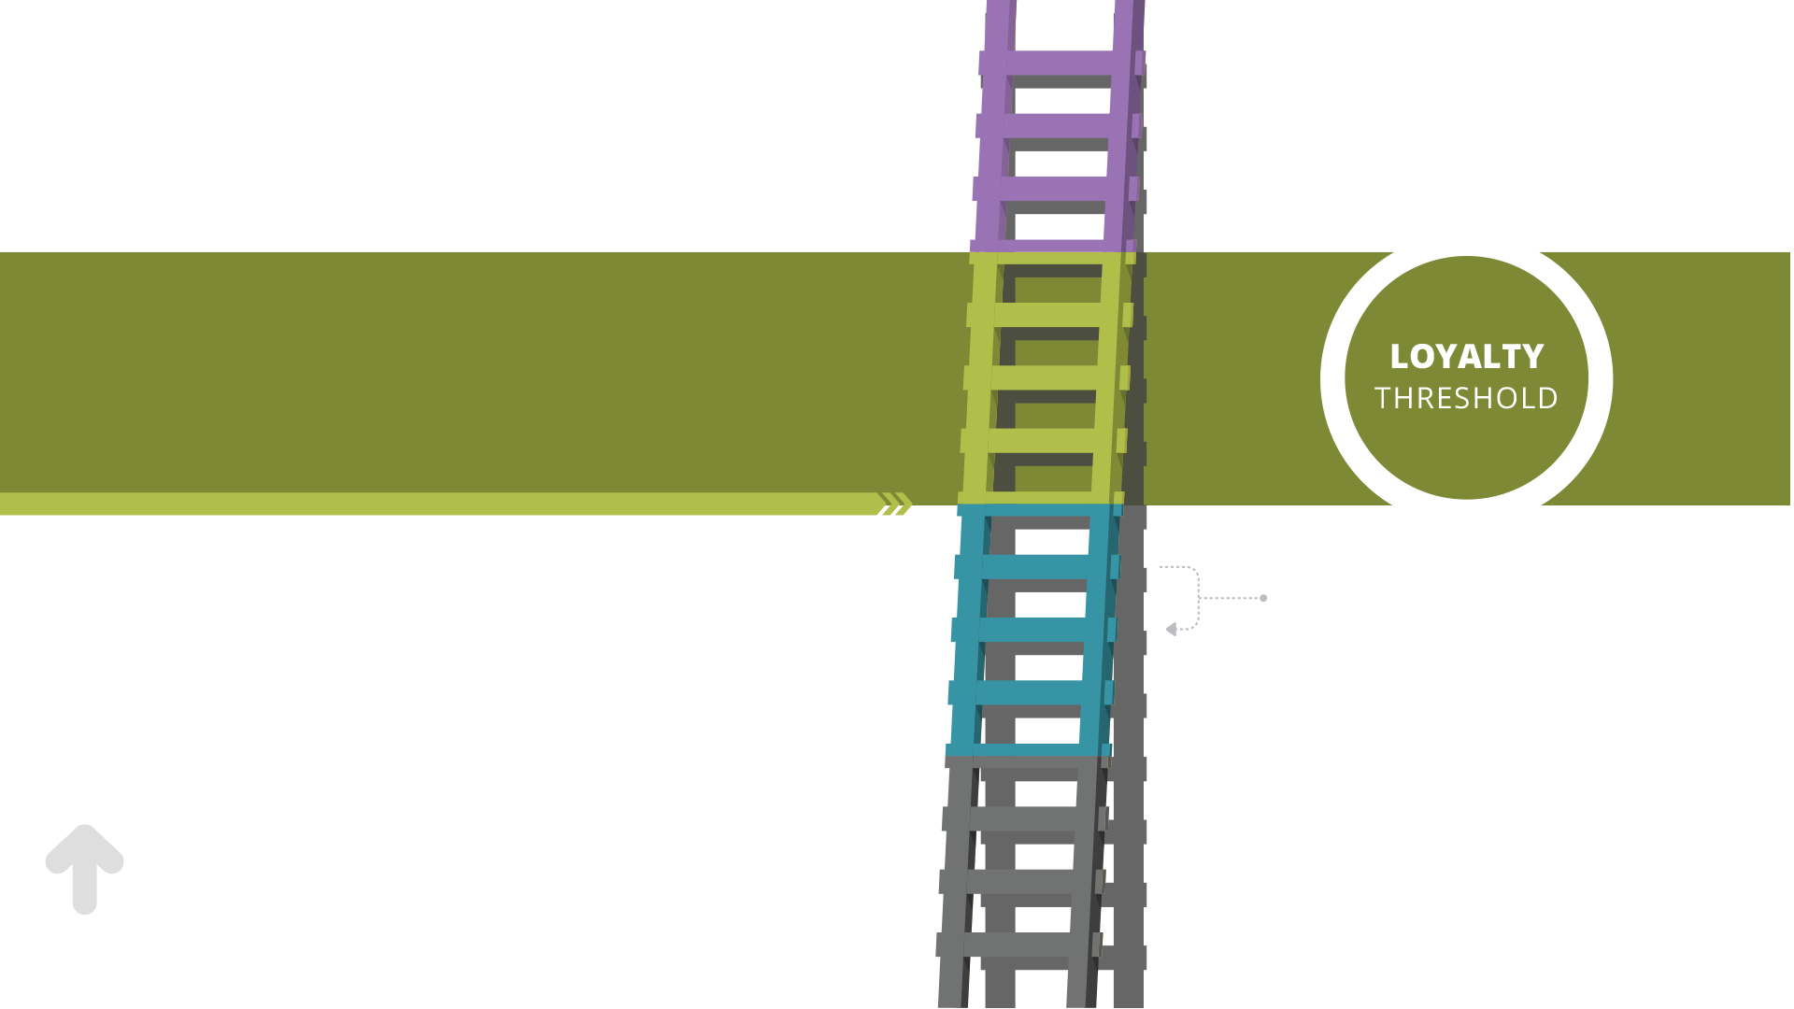
This is the point at which they have self-determined that they will use your product or service again in the future.
They will not hunt for a competitor.
They trust you to deliver on your
brand promise again.
Bad Experience.

Slide 44
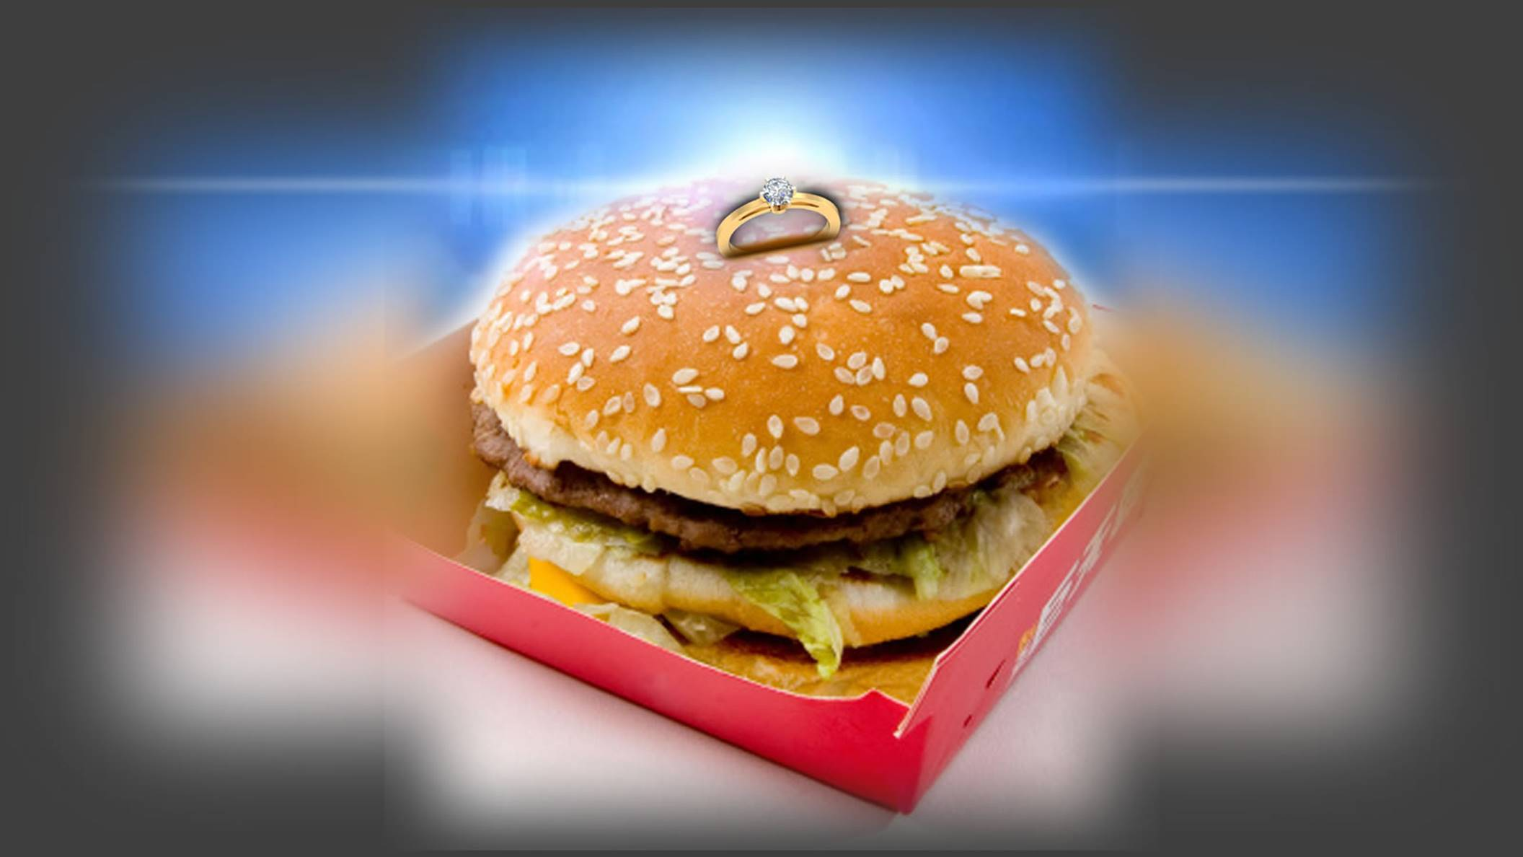

Slide 45
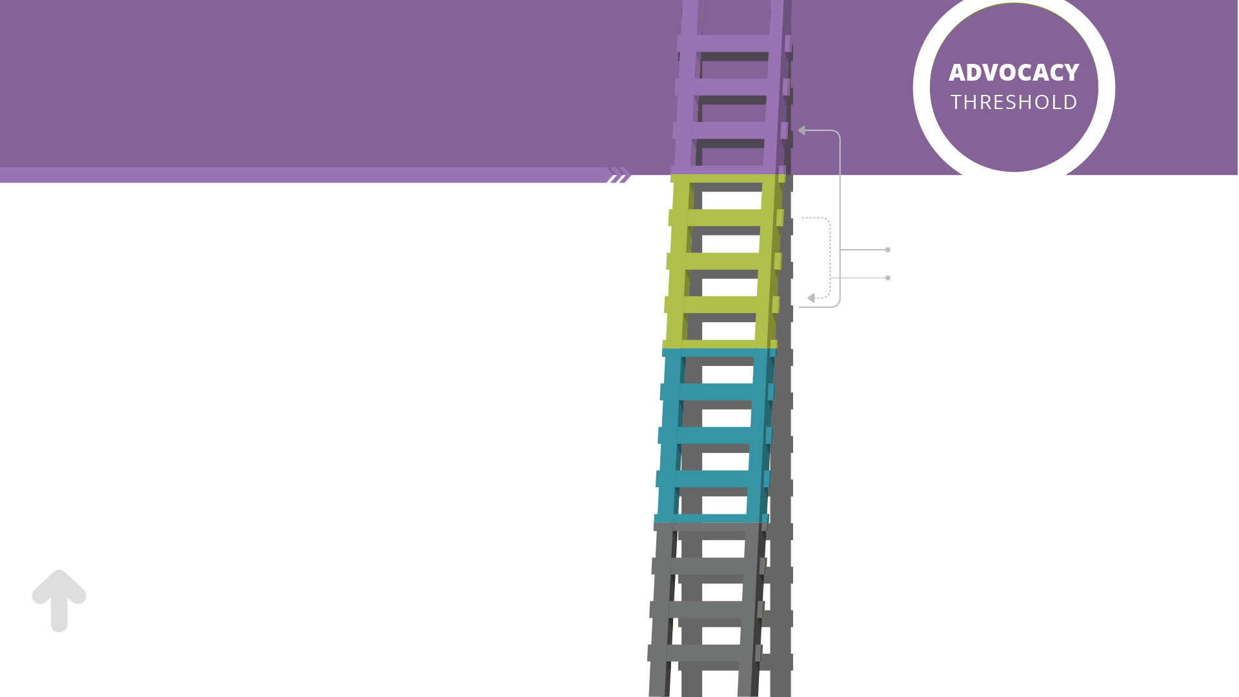
This is the point where your customer invests their time and personal energy into your product.
It could be them giving you unsolicited feedback about your product.
It could be them bragging about your product to their friends & family
An advocate has put
their personal seal of
approval on your brand.
it becomes much more difficult for them to move down the
ladder.

Slide 46
“An inspired customer, willing
to defend and promote your brand
is one of the best investments
that you can make.”

Slide 47
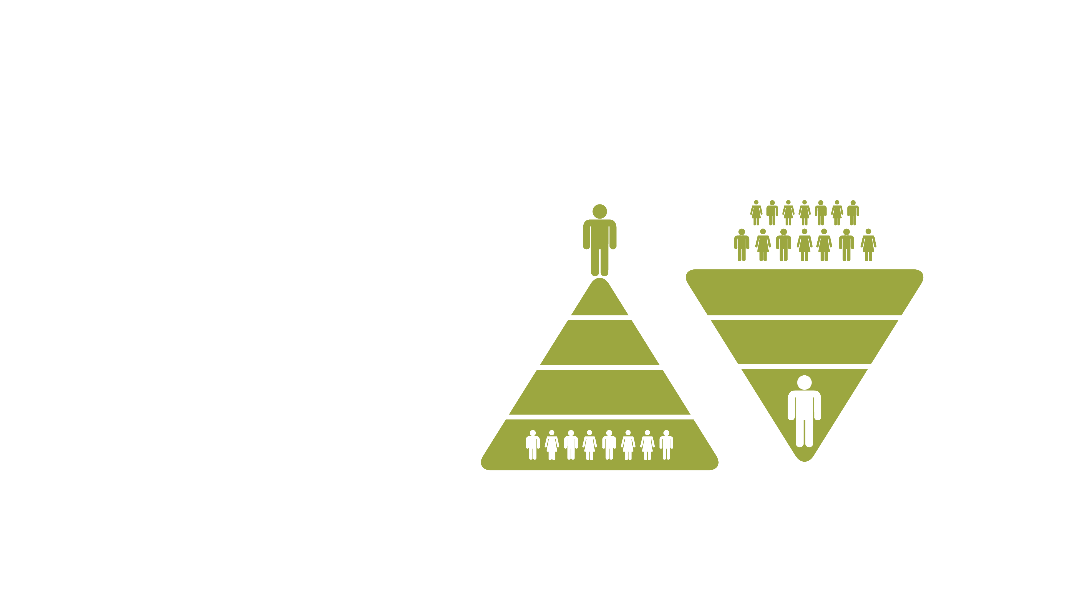
Customer Power.
We’re Disillusioned.
73% of Customers leave
because of dissatisfactory customer service.
Companies losing the customer,
Believe that only 21% leave because
of dissatisfactory customer service.
Source: http://www.bautomation.com/resources/articles/startling-statistics-on-customer-retention-acquisition/489

Slide 48
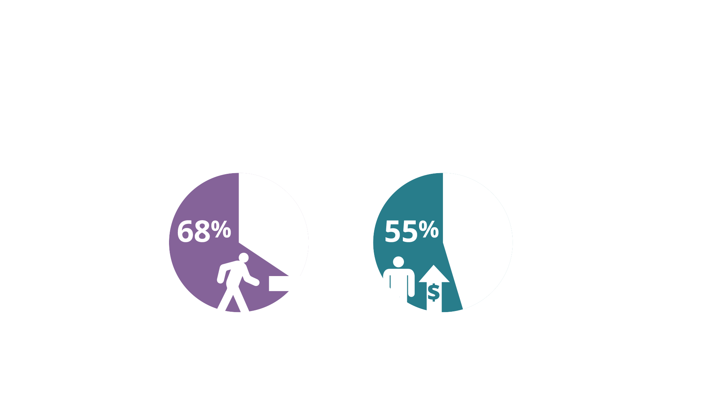
Service.
How We Treat Our Customers Matters
Source: http://www.retentionscience.com/the-top-4-reasons-customers-churn-and-how-to-prevent-it White House Office of Consumer Affairs

Slide 49
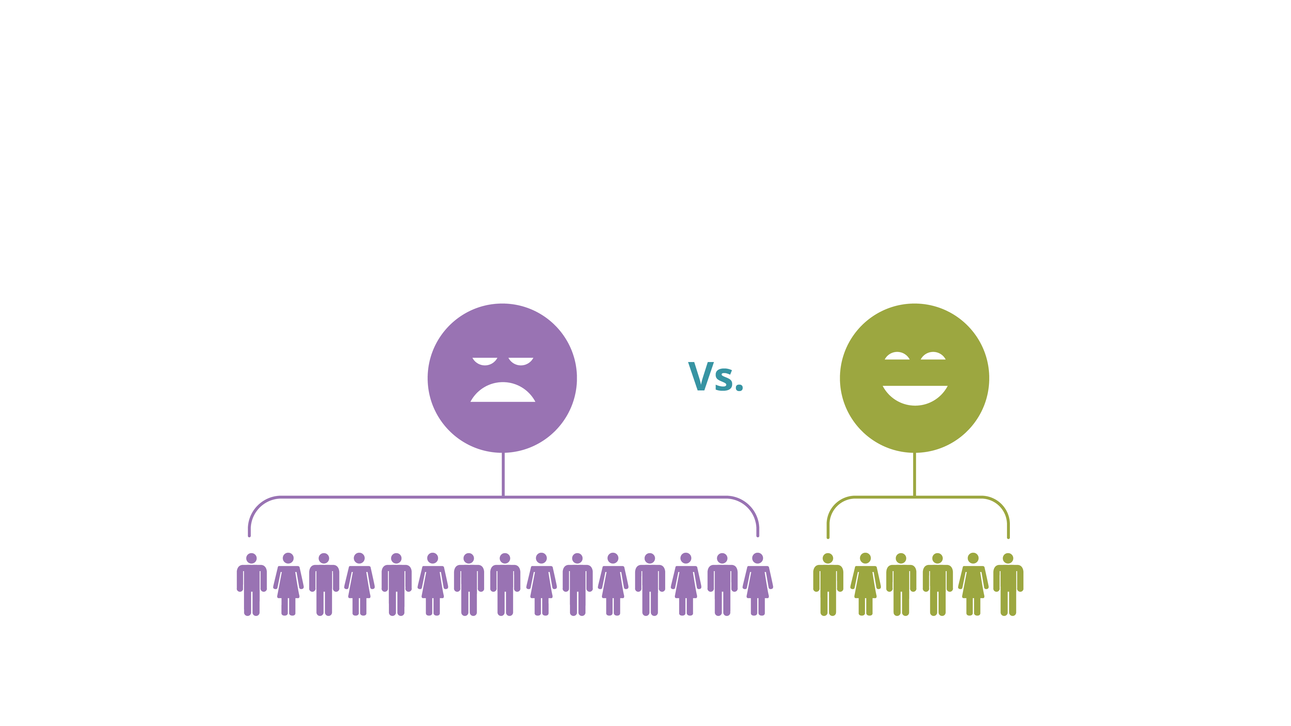
Service.
How We Treat Our Customers Matters
Source: http://www.retentionscience.com/the-top-4-reasons-customers-churn-and-how-to-prevent-it White House Office of Consumer Affairs

Slide 50
Listen.
How To Identify Your
Customer’s Needs

Slide 51
“People don’t know
what they want until you show it
to them.”

Slide 52
“People don’t know
what they want until you show it
to them.”
- Steve Jobs.

Slide 53
“It isn’t normal to know
what we want. It’s a rare and difficult psychological achievement.”

Slide 54
“It isn’t normal to know
what we want. It’s a rare and difficult psychological achievement.”
- Abraham Maslow.

Slide 55
“If I had asked my customers
what they wanted, they would’ve said
faster horses.”

Slide 56
“If I had asked my customers
what they wanted, they would’ve said
faster horses.”
– Henry Ford.

Slide 57
“If I had asked my customers
what they wanted, they would’ve said
faster horses.”
– Unknown (but Wise) Consultant.

Slide 58
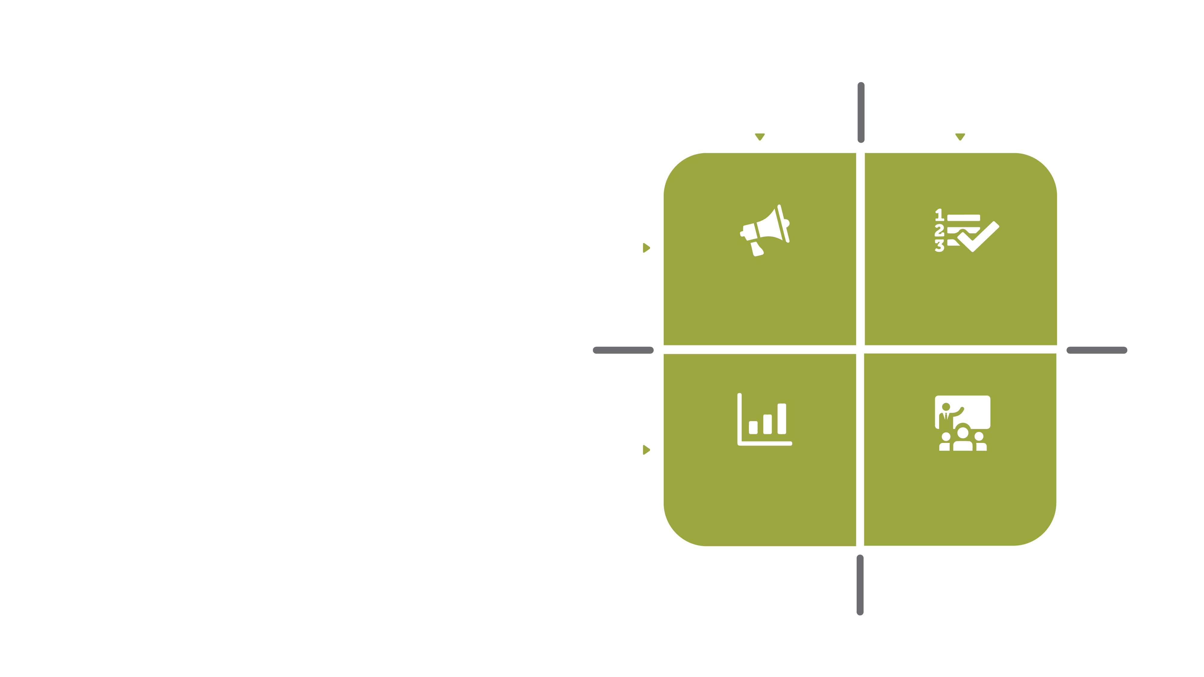
The Voice
of Customer.
Passive
Active
A model for maximizing our understanding of needs and wants
Direct
User
Feedback
Surveys
Focus Groups
Indirect
Activity
Analysis
Workshops

Slide 59
Surveys Focus
Groups.
Passive
Active
Active/Direct
Direct
- Customer Surveys (NPS)
- Customer Focus Groups
- Customer Communities
- User Studies & Testing
User
Feedback
Surveys
Focus Groups
Indirect
Activity
Analysis
Workshops

Slide 60
User Feedback.
Passive
Active
Passive/Direct
- Feedback
- Customer Service Calls
Direct
User
Feedback
Surveys
Focus Groups
Indirect
Activity
Analysis
Workshops

Slide 61
Activity Analysis.
Passive
Active
Passive/Indirect
- Competitive Analysis
- Analytics
- Service Logs
Direct
User
Feedback
Surveys
Focus Groups
Indirect
Activity
Analysis
Workshops

Slide 62
Workshops.
Passive
Active
Active/Indirect
- Team Surveys
- Workshops
Direct
User
Feedback
Surveys
Focus Groups
Indirect
Activity
Analysis
Workshops

Slide 63
Simon Sinek.
WHAT

Slide 64
Simon Sinek.
HOW
WHAT

Slide 65
Simon Sinek.
WHY
HOW
WHAT

Slide 66
Start With Why.
“People don’t buy what you do,
They buy why you do it."
- Simon Sinek
WHY
HOW
WHAT

Slide 67
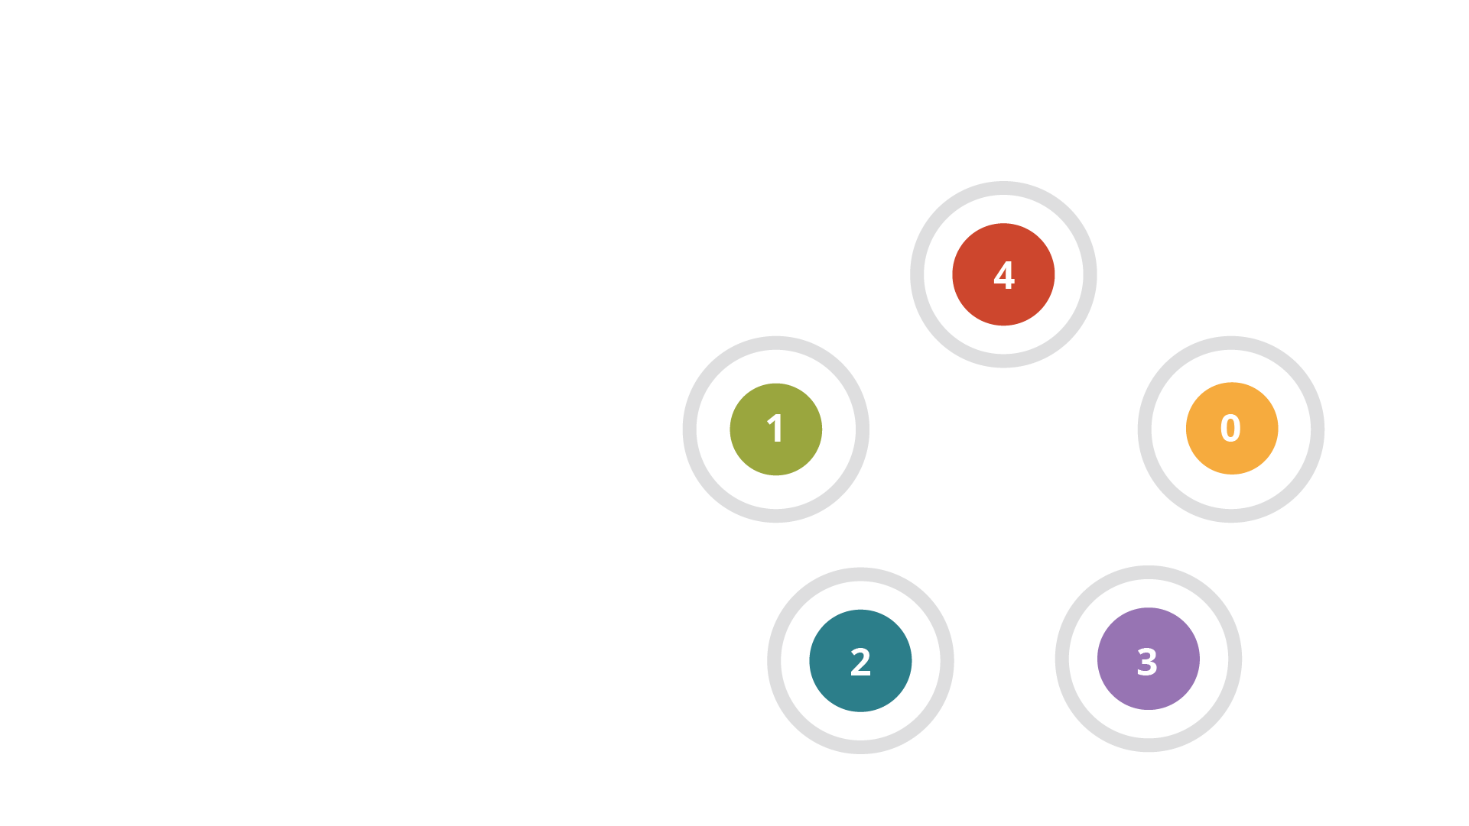
Concern Mapping.
Identifying and Mapping
What Your Customers Value.
- The Hoshin Star

Slide 68
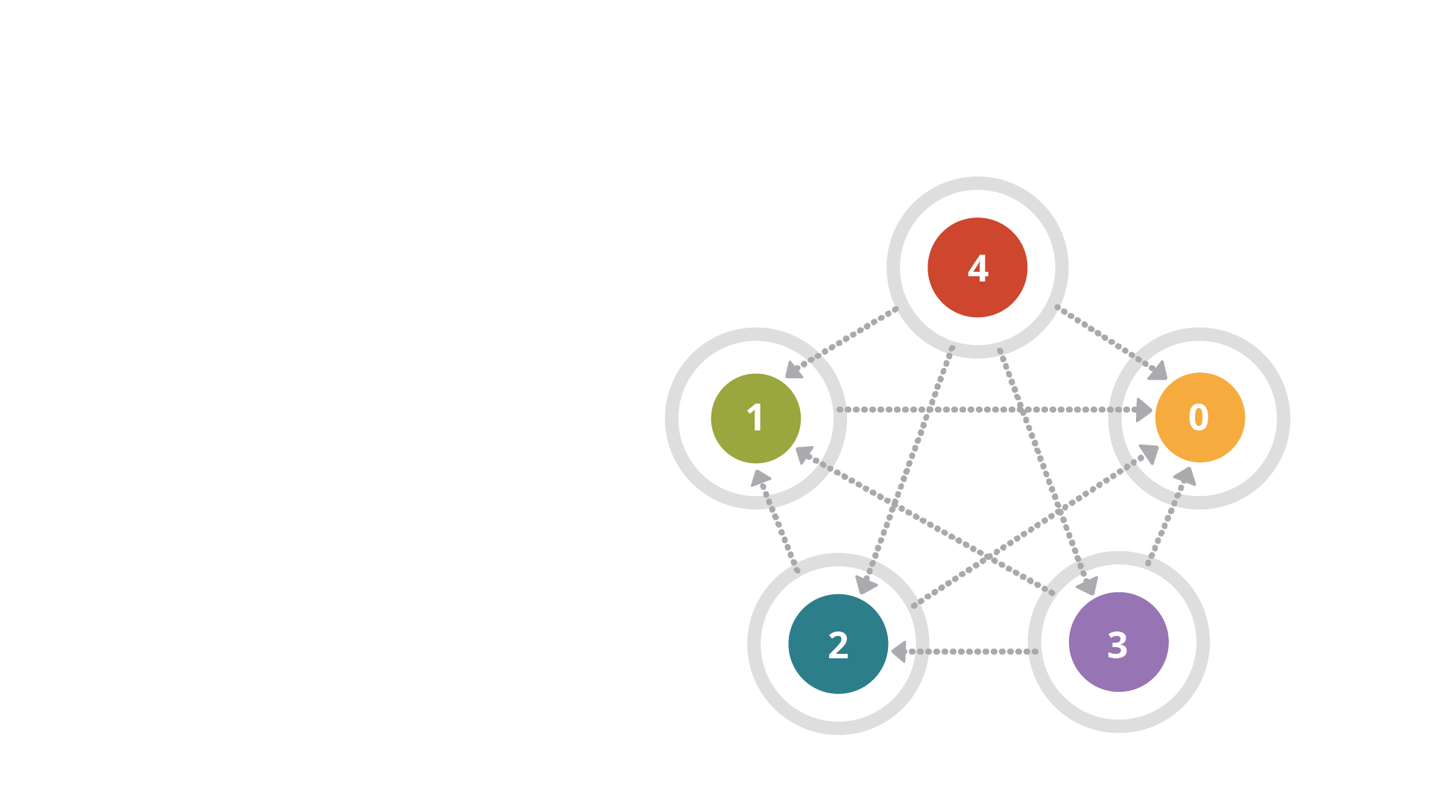
Concern Mapping.
Identifying and Mapping
What Your Customers Value
- The Hoshin Star

Slide 69
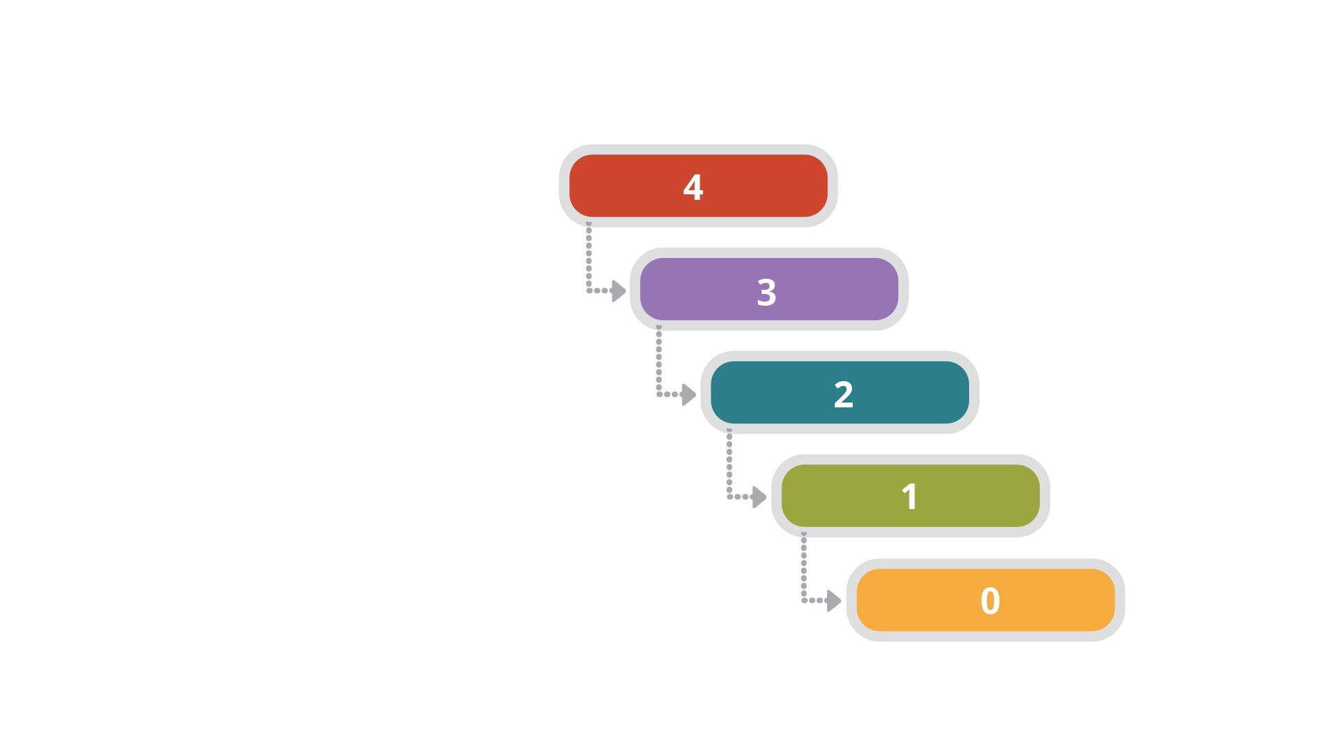
The Cascade
of Concerns.
Feature Prioritization Tool

Slide 70
"Strategy without tactics
is the slowest path to victory.
Tactics without strategy
is that noise that you hear
right before defeat."
– Sun Tzu

Slide 71
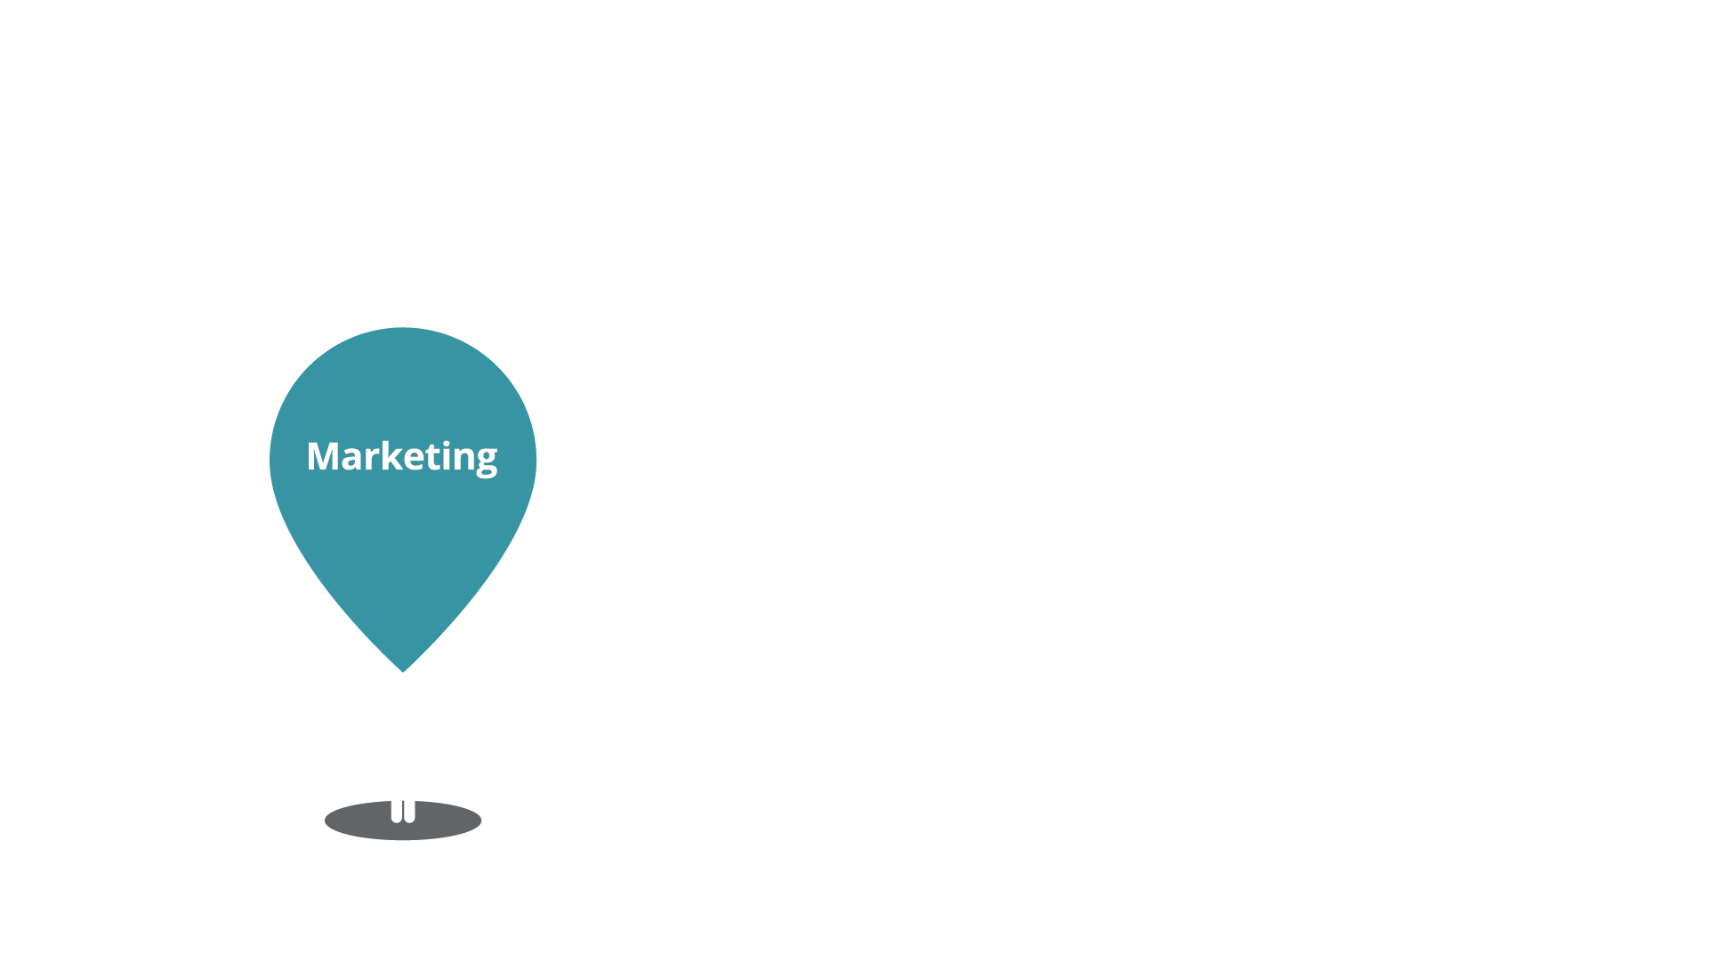
Your Customer’s Journey.

Slide 72
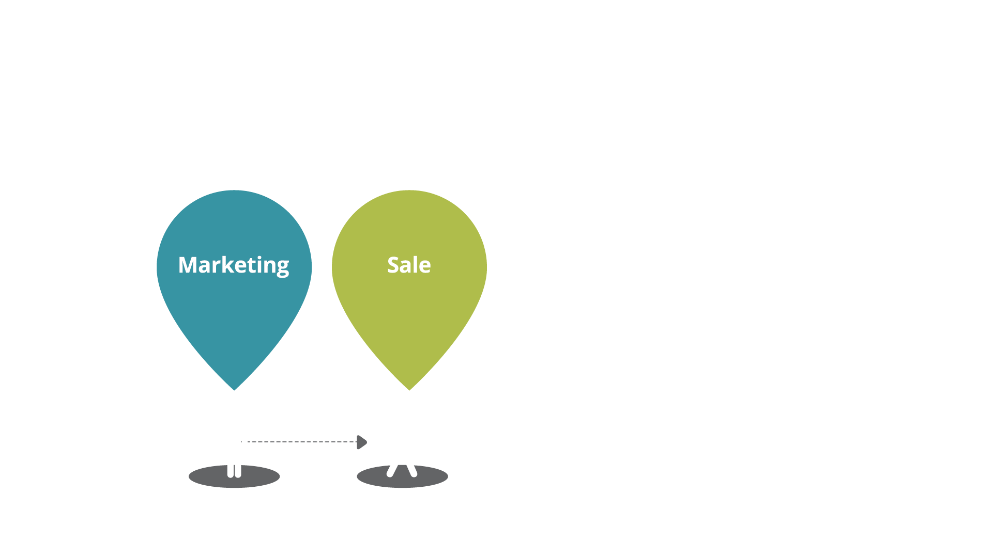
Your Customer’s Journey.

Slide 73
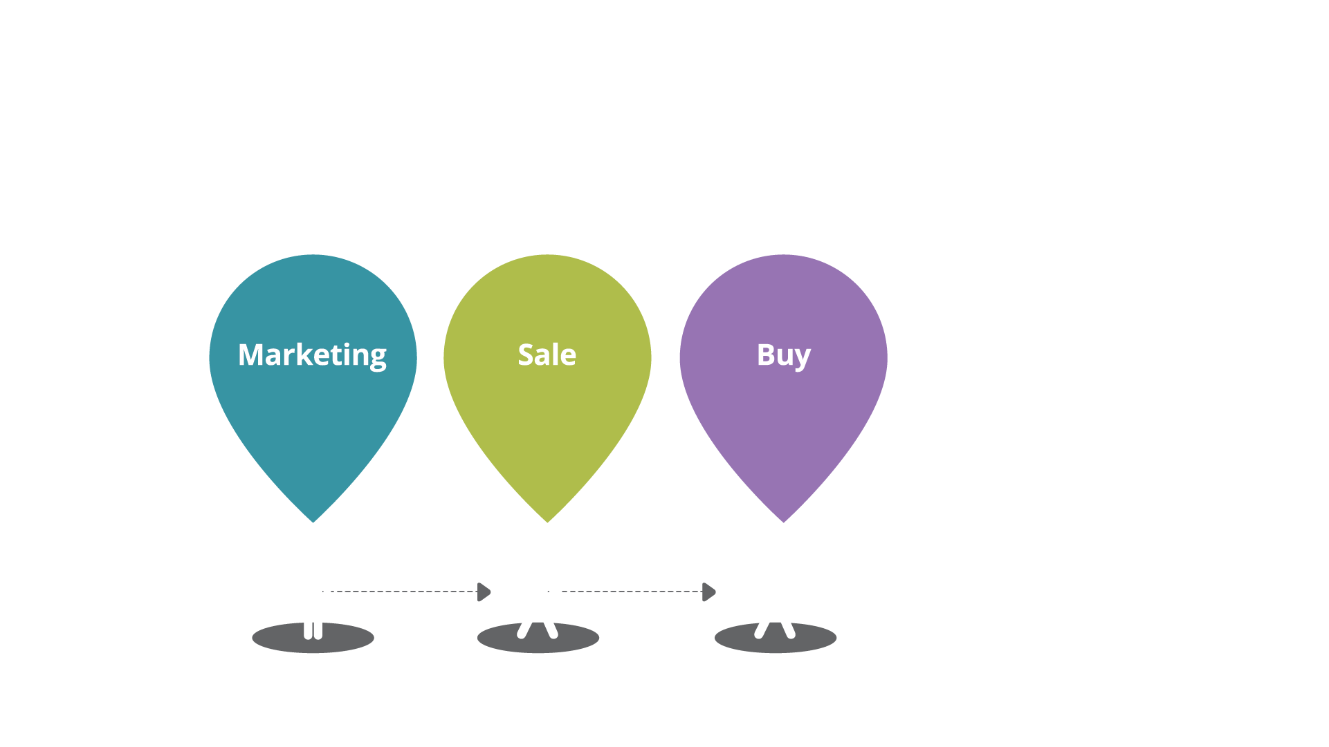
Your Customer’s Journey.

Slide 74
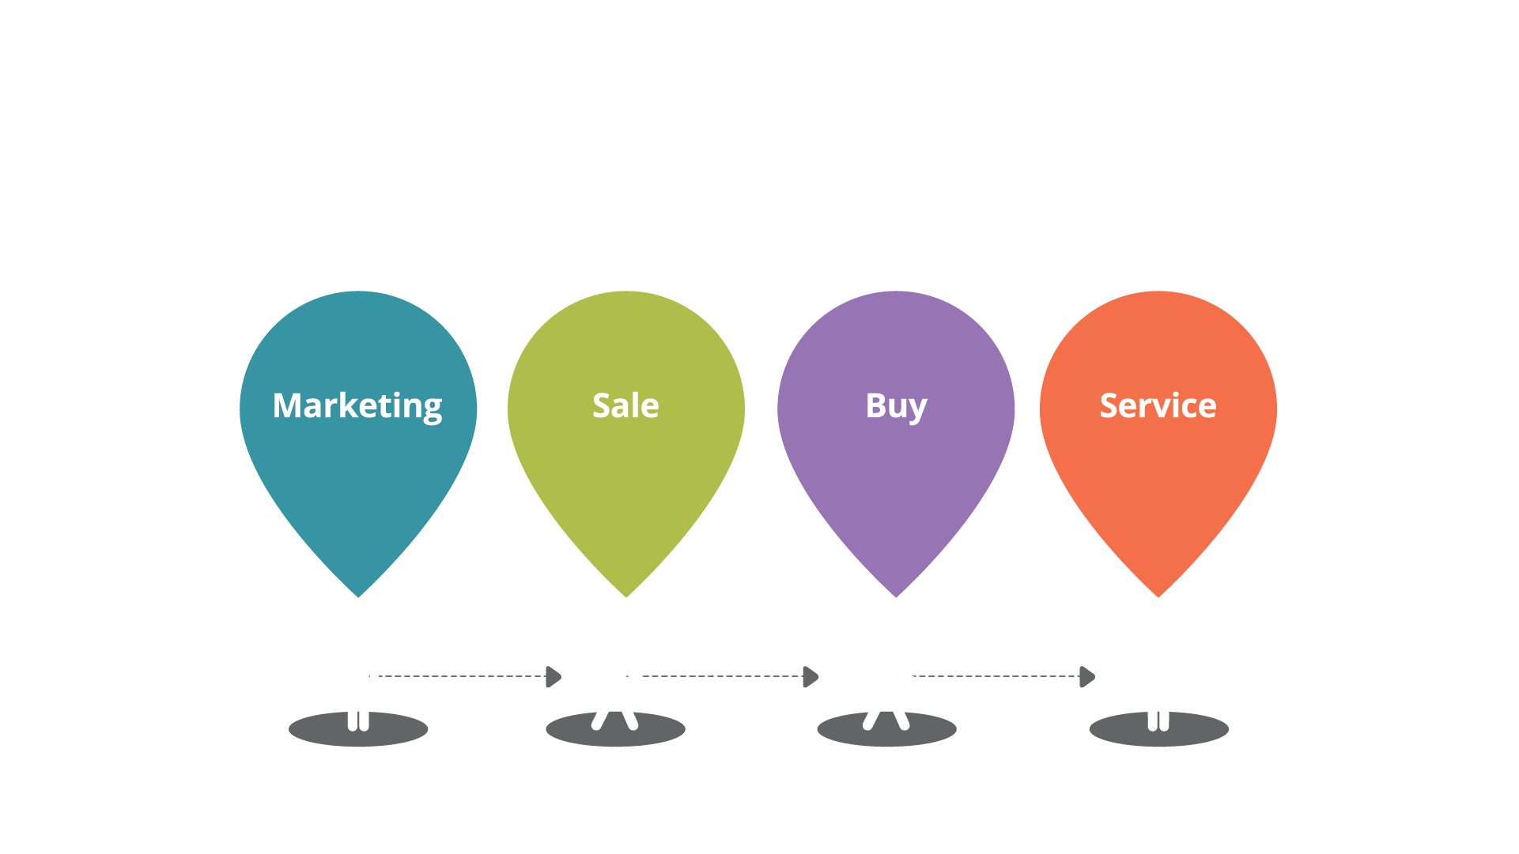
Your Customer’s Journey.

Slide 75
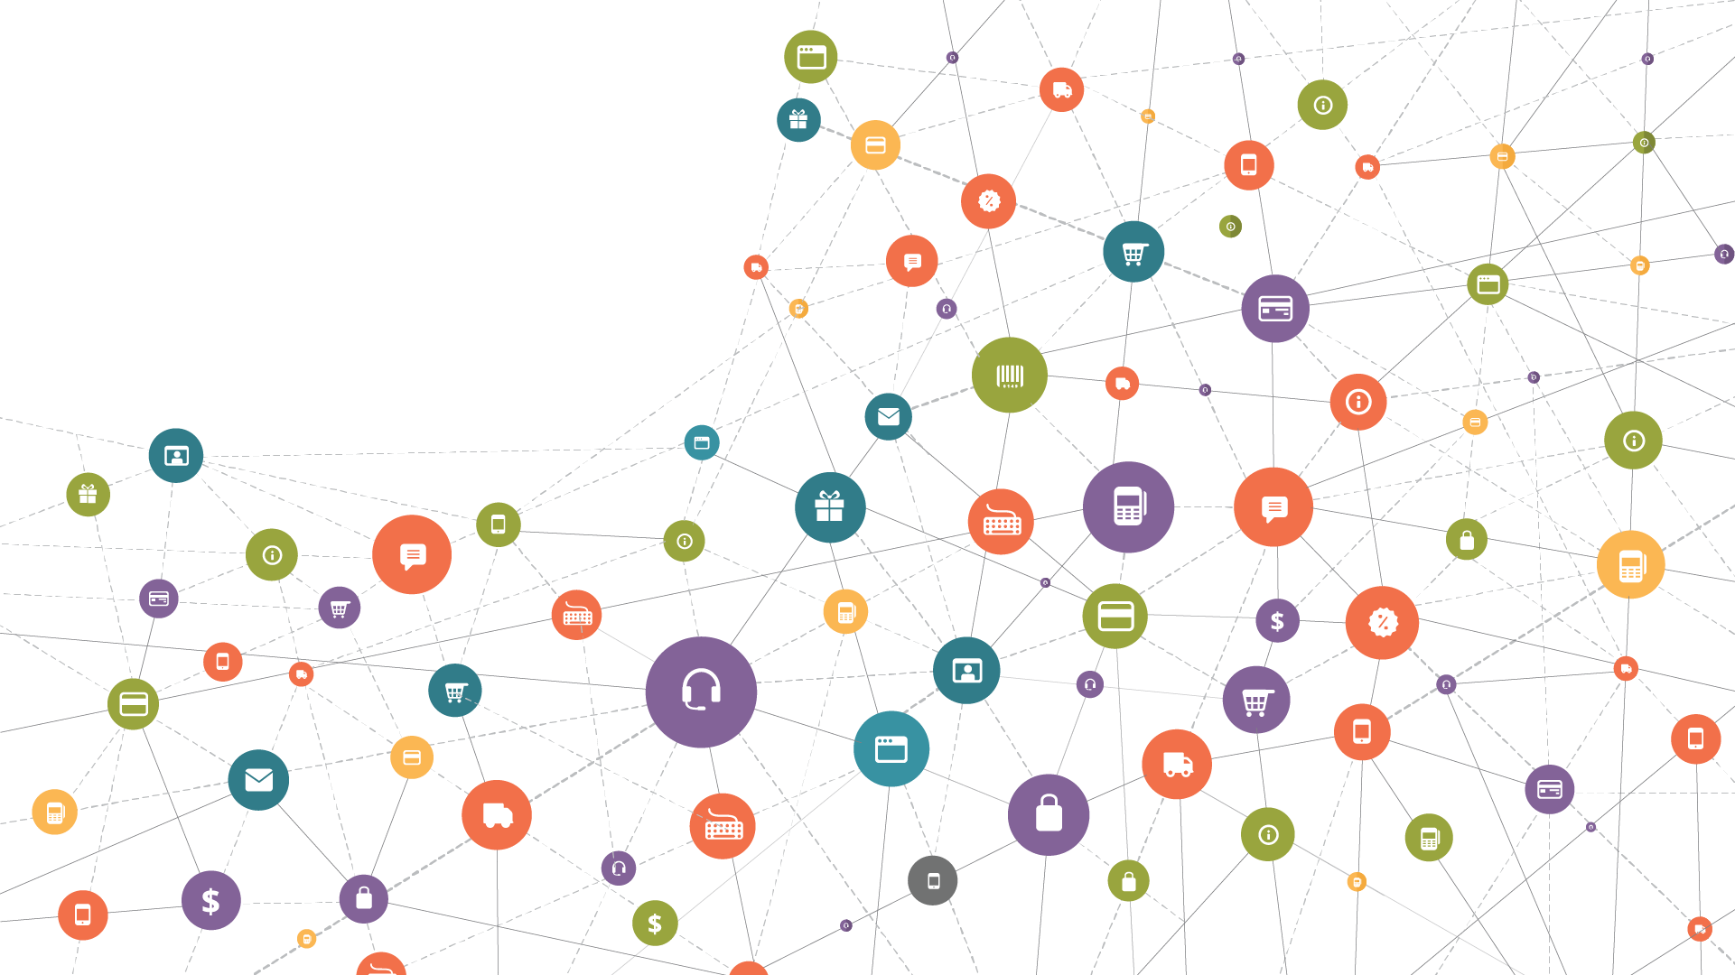
The Customer’s
Actual Journey.

Slide 76
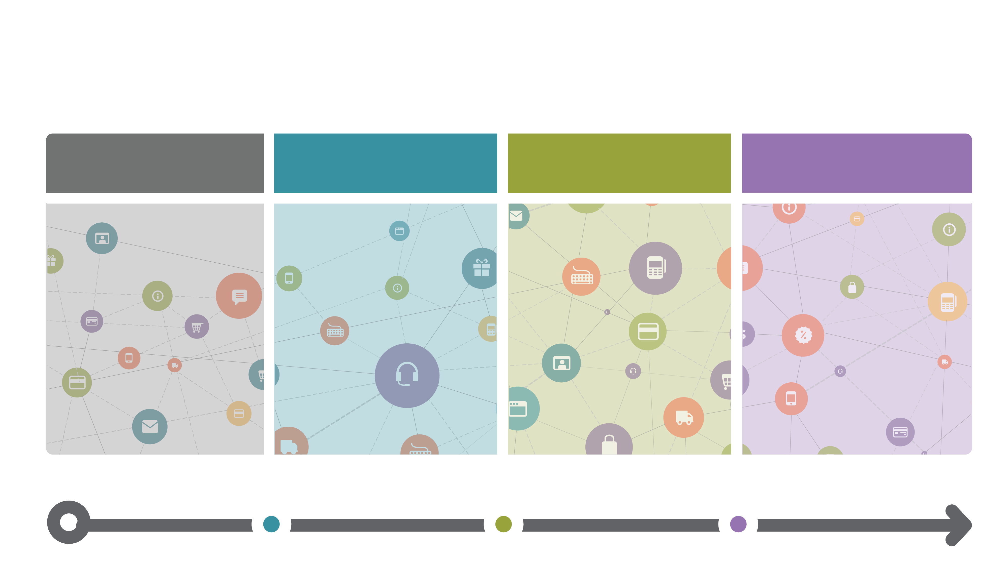
The Journey Framework.
Awareness
Trust
Loyalty
Advocacy

Slide 77
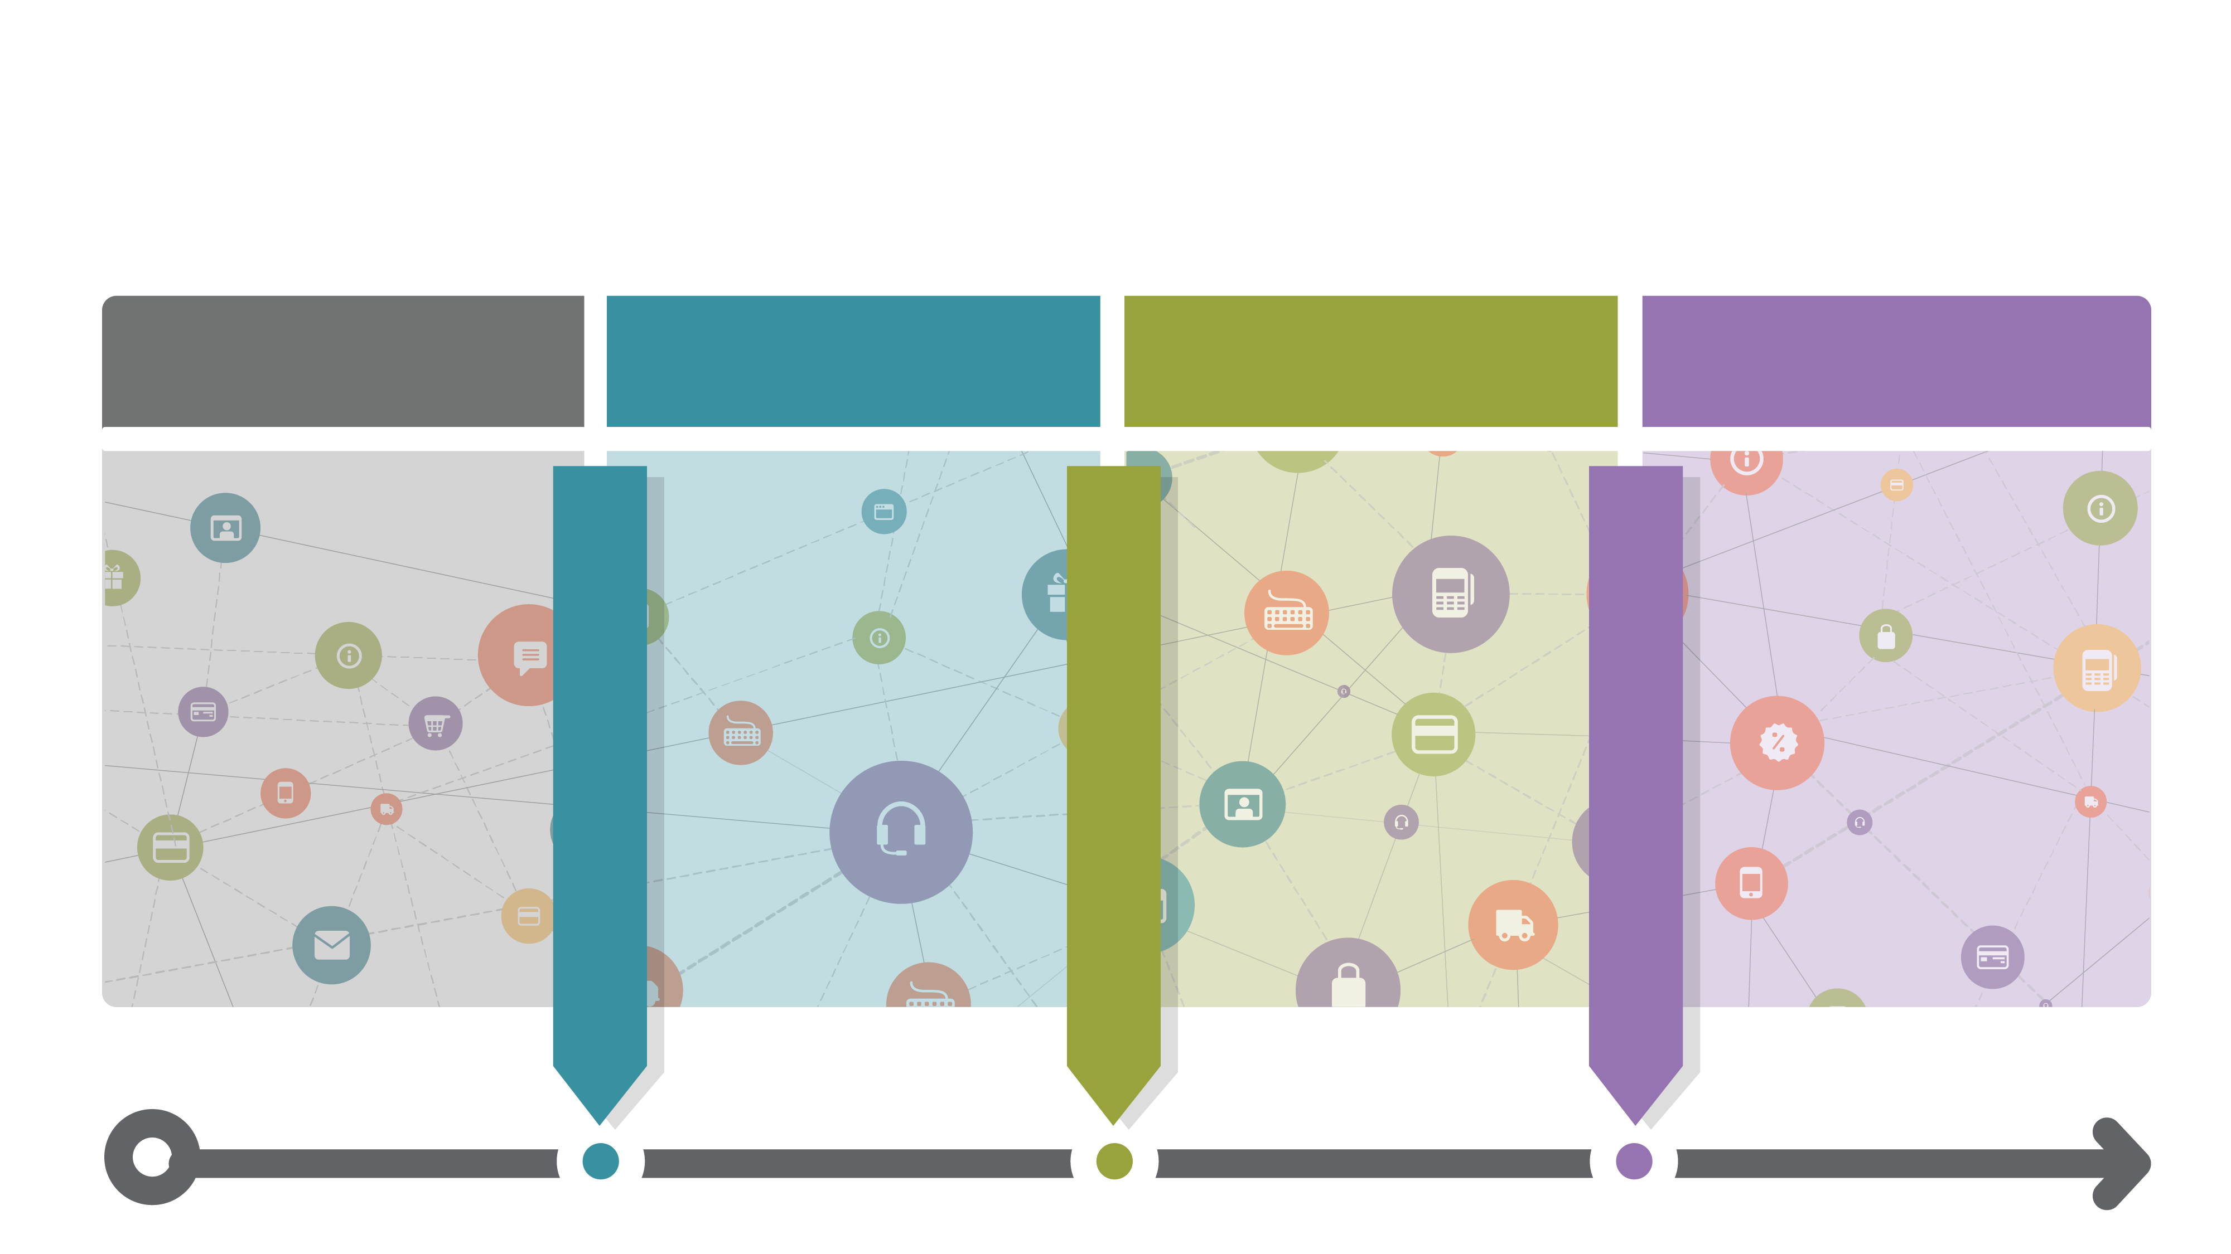
Thresholds.
Awareness
Trust
Loyalty
Advocacy

Slide 78
The Journey Framework.
Awareness
Trust
Loyalty
Advocacy
Investment
Behavior
Regular
Usage
Sharing
Behaviors
Trust Threshold
Loyalty Threshold
Advocacy Threshold
Conversions
Active Users
Feedback

Slide 79
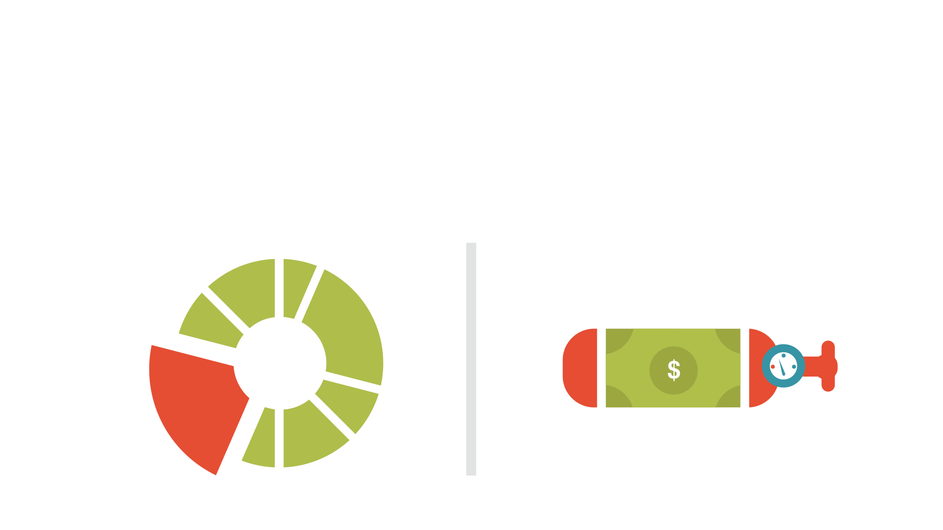
Measuring Software Product Success.
Product Usage vs Product Oxygen
PRODUCT USAGE
PRODUCT OXYGEN

Slide 80
Key Performance Indicators (KPI’s)
BEHAVIOUR
MEASURES
STAKEHOLDER
MEASURES
Trust
Loyalty
Advocacy
ROI
Growth
Conversions

Slide 81
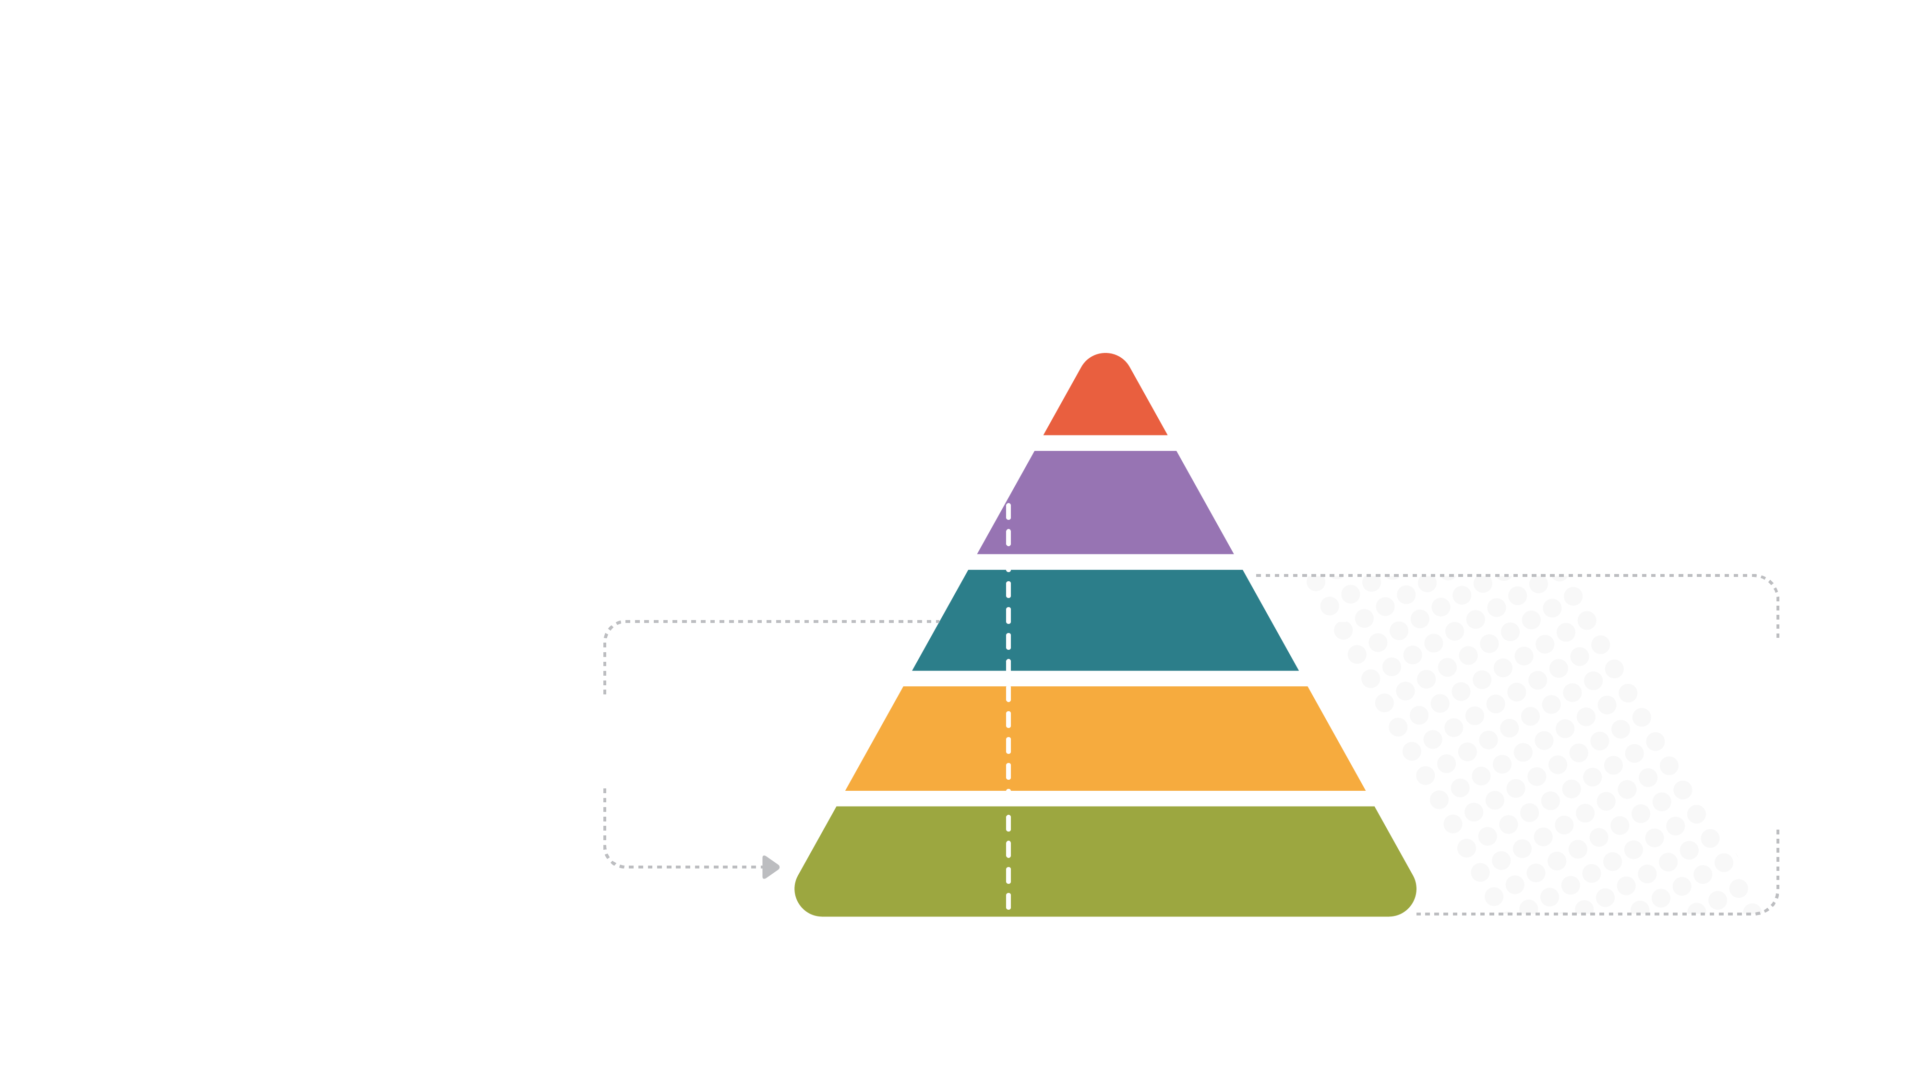
Product Metrics
The Relationship Between Different Metrics
ROI
Business Outcome Metrics
NPS
Customer Sentiment Metrics
Advocacy
Feature-
Level
Metrics
User
Behavior
Metrics
Feeds
Loyalty
Trust
Drive

Slide 82
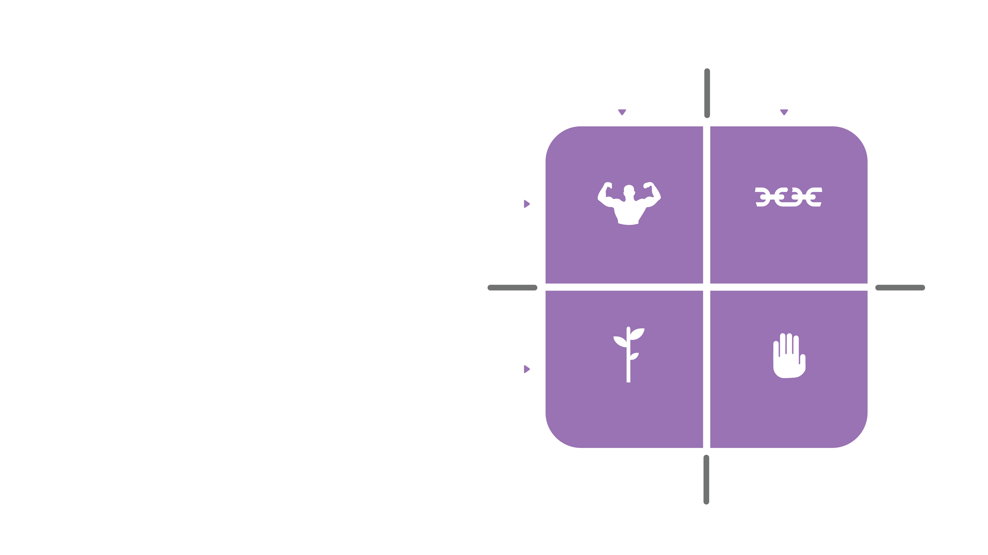
S.W.O.T.
Positive
Negative
Strengths, Weaknesses,
Opportunities And Threats
Now
(past)
Strengths
Weaknesses
Future
Opportunities
Threats

Slide 83
Strengths.
Positive
Negative
What’s going well?
Now
(past)
Strengths
Weaknesses
Future
Opportunities
Threats

Slide 84
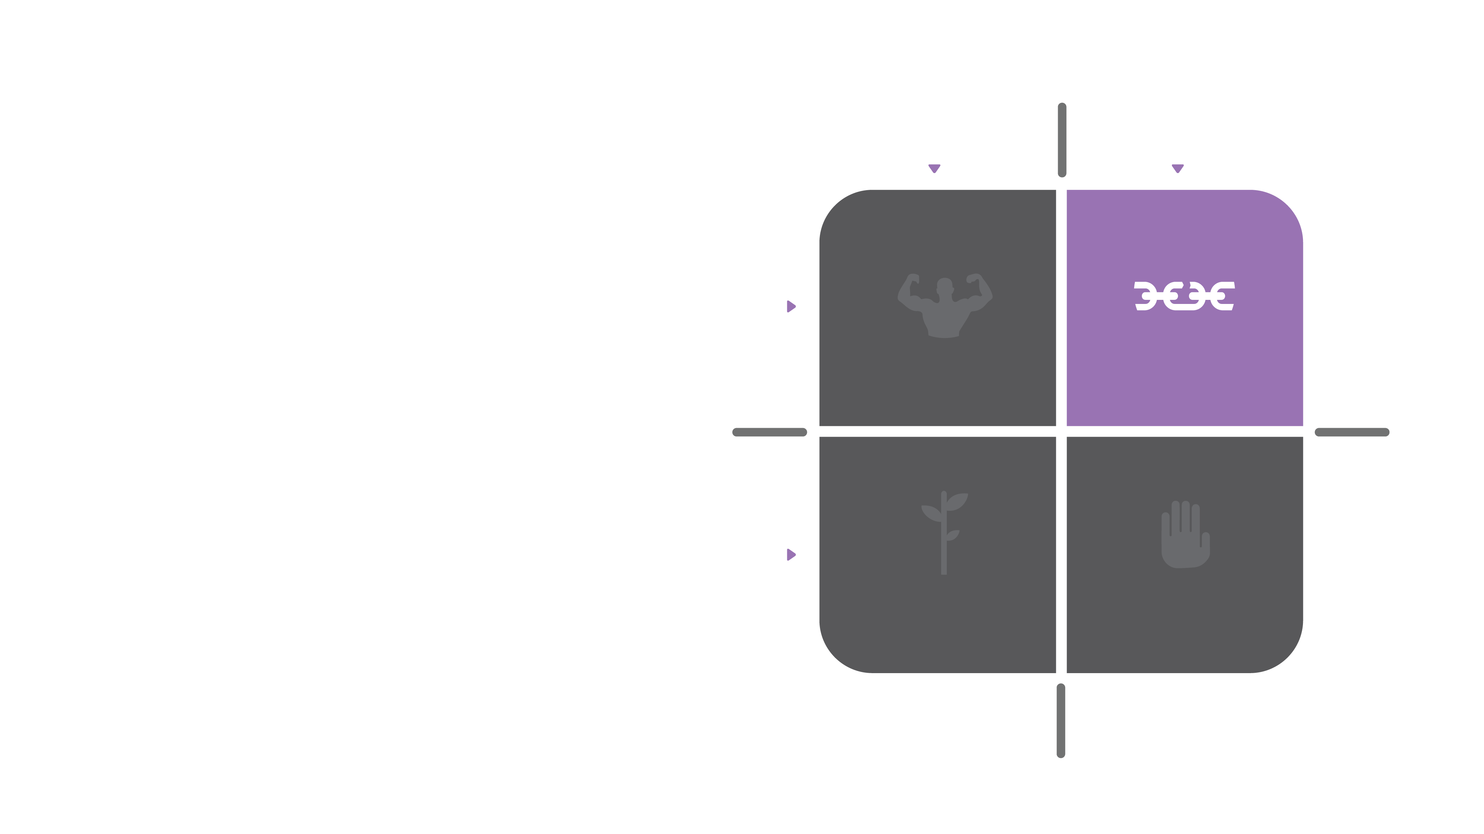
Weaknesses.
Positive
Negative
Where are we falling down?
Now
(past)
Strengths
Weaknesses
Future
Opportunities
Threats

Slide 85
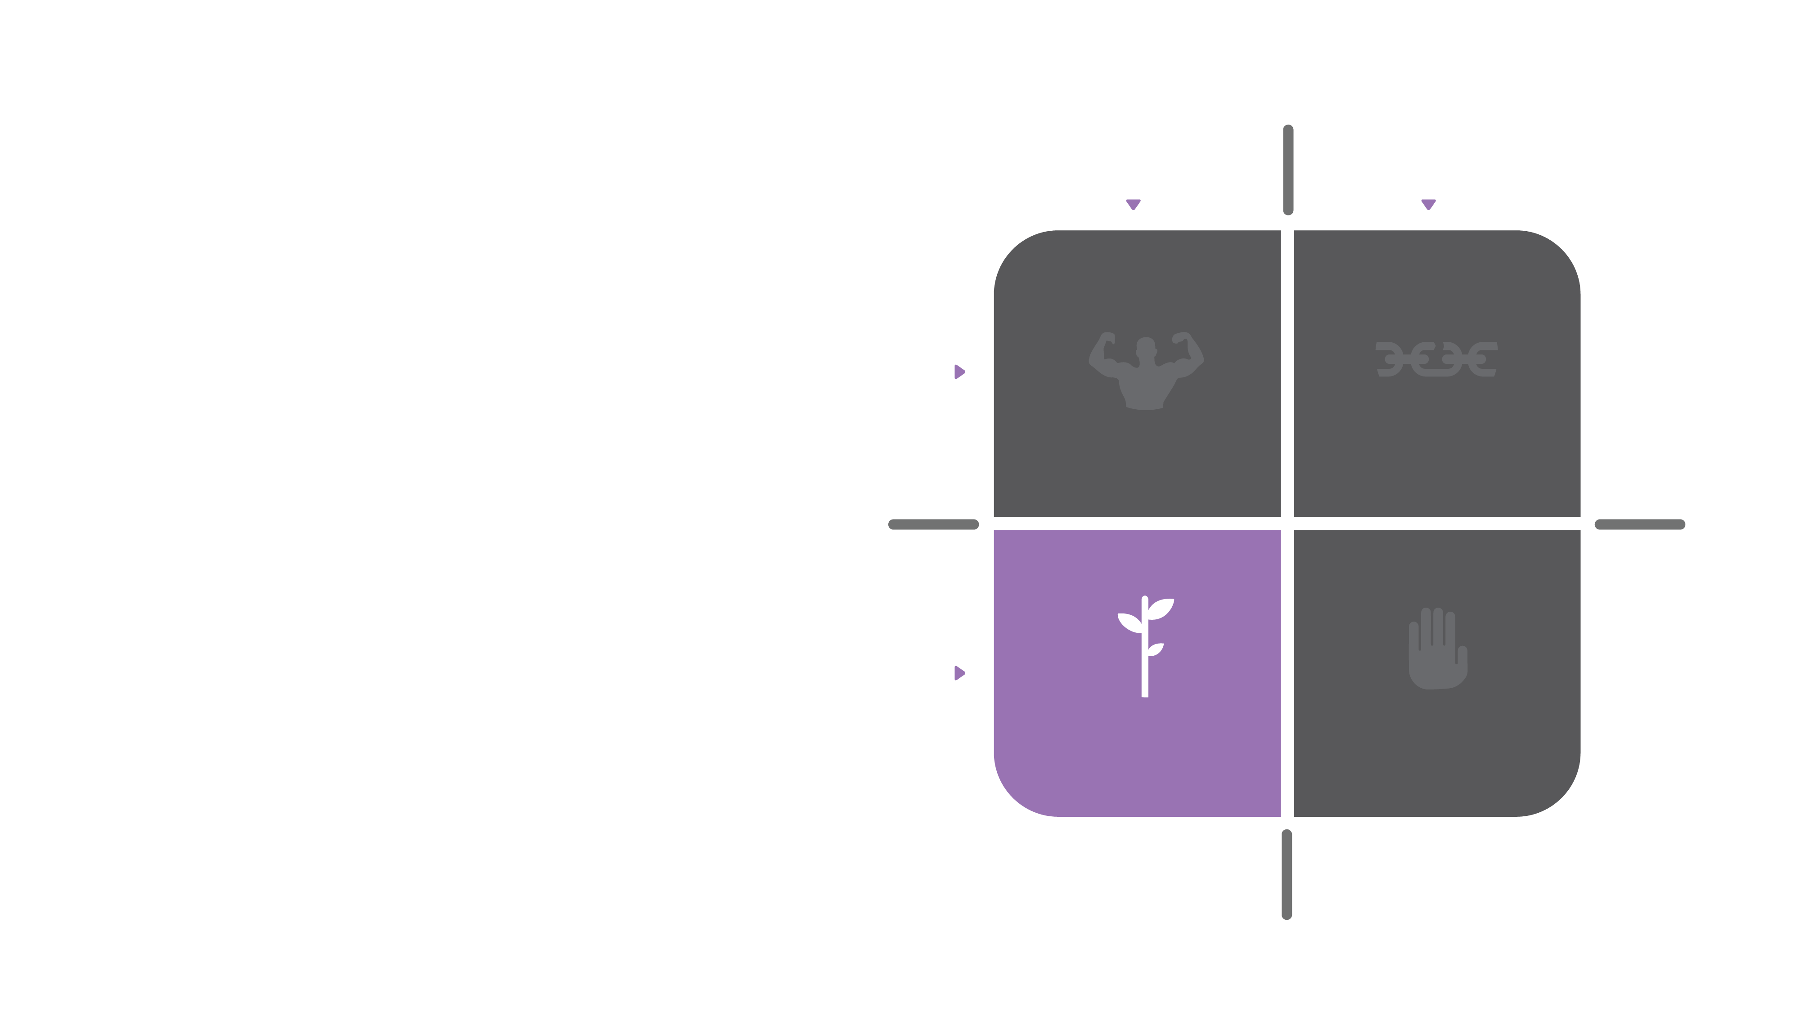
Opportunities.
Positive
Negative
What are the key market opportunities?
Now
(past)
Strengths
Weaknesses
Future
Opportunities
Threats

Slide 86
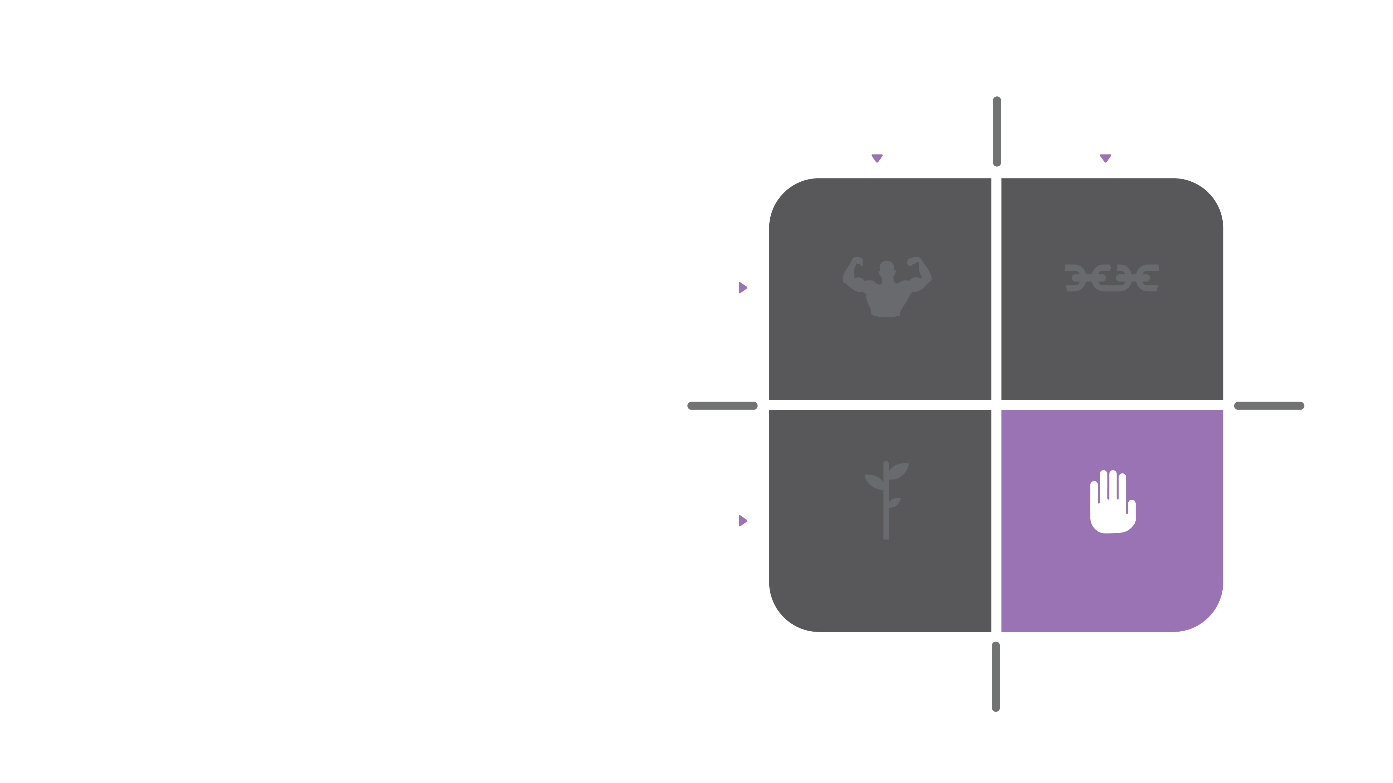
Threats.
Positive
Negative
What happens if we do nothing?
Now
(past)
Strengths
Weaknesses
Future
Opportunities
Threats

Slide 87
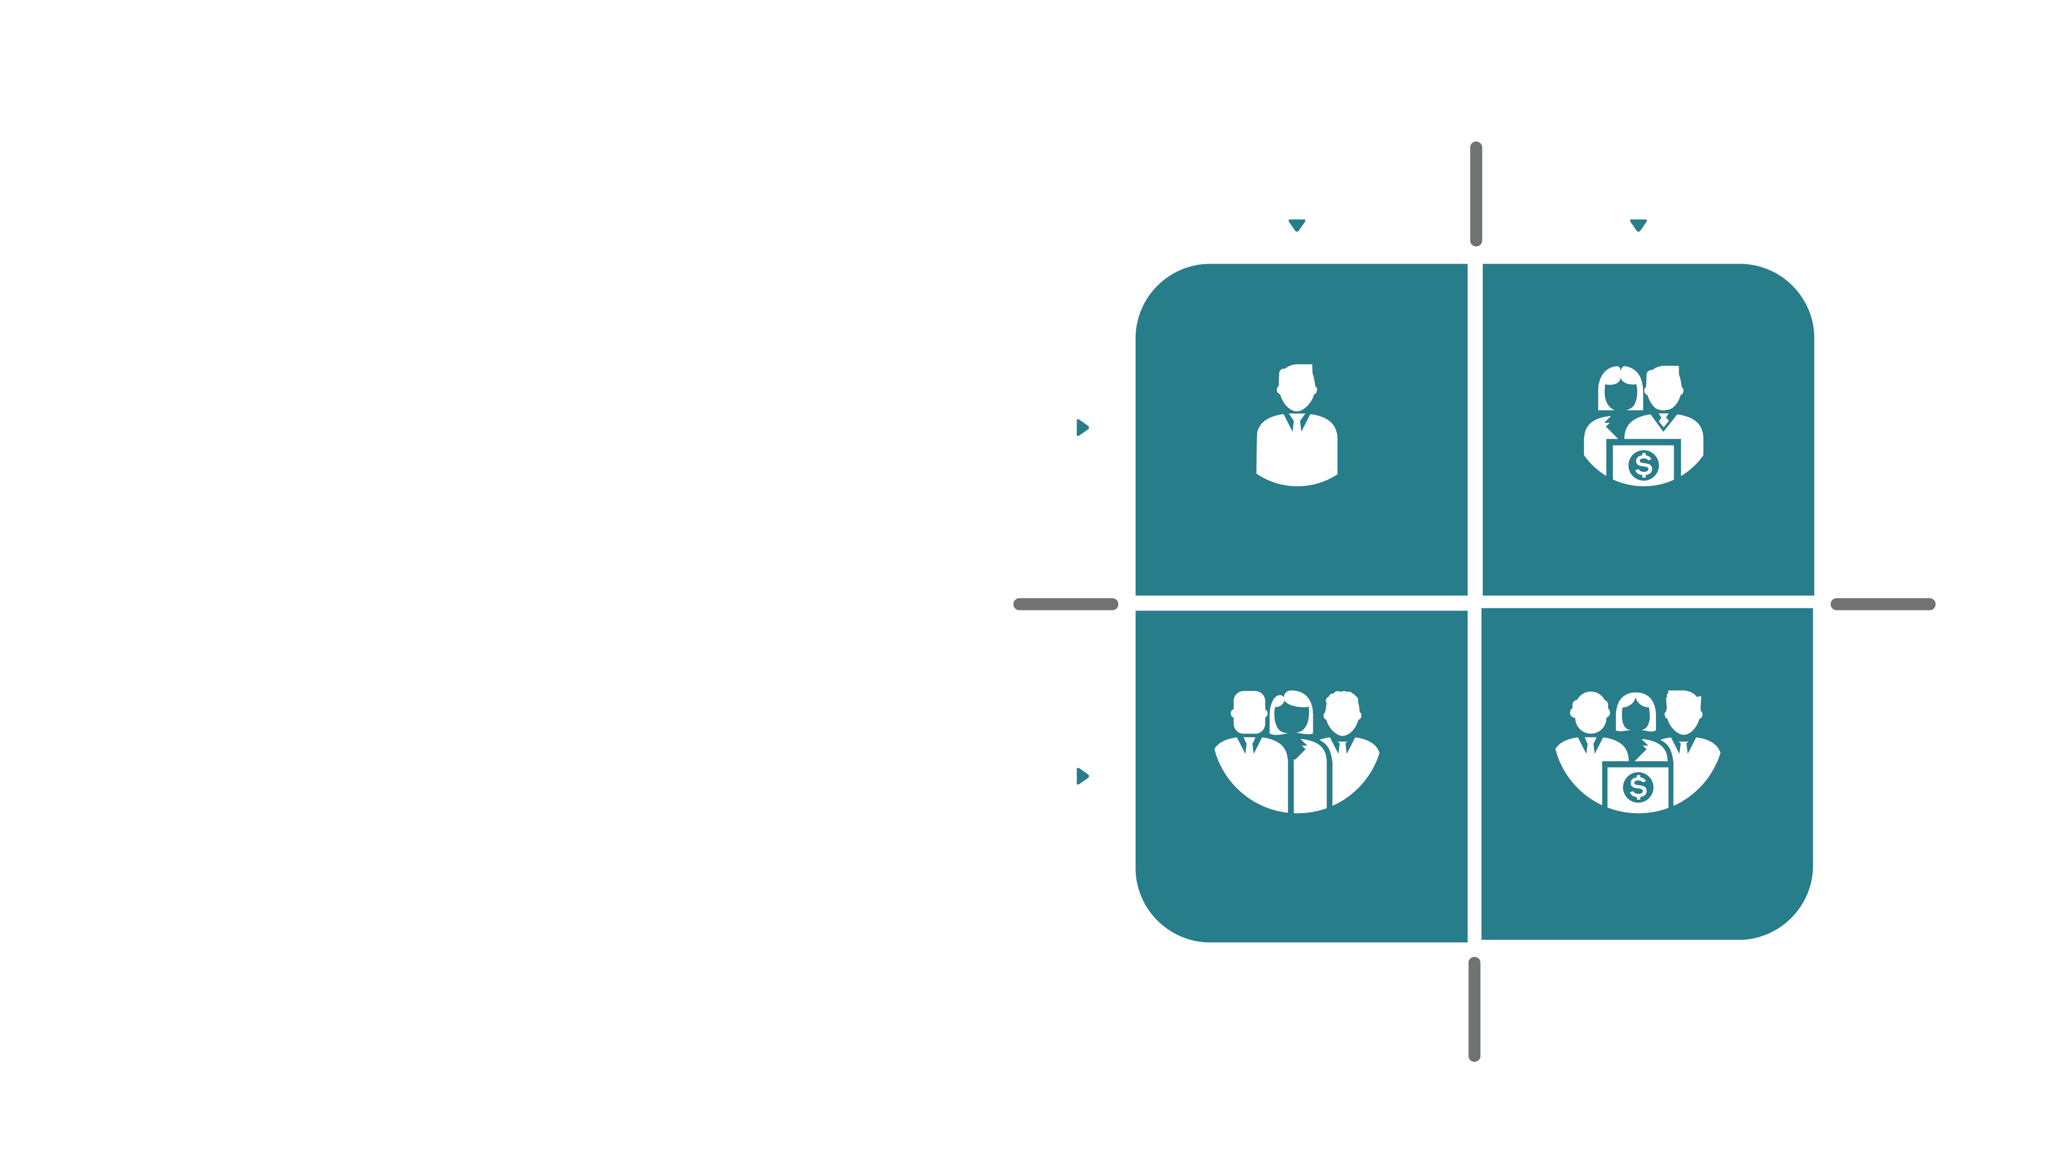
Your Ecosystem.
Internal
External
Who We Serve
Individual
“I”
“She/He”
Groups
“We”
“They”

Slide 88
Your Ecosystem.
Internal
External
Internal Stakeholders
Administrative Users
Individual
“I”
“She/He”
Groups
“We”
“They”

Slide 89
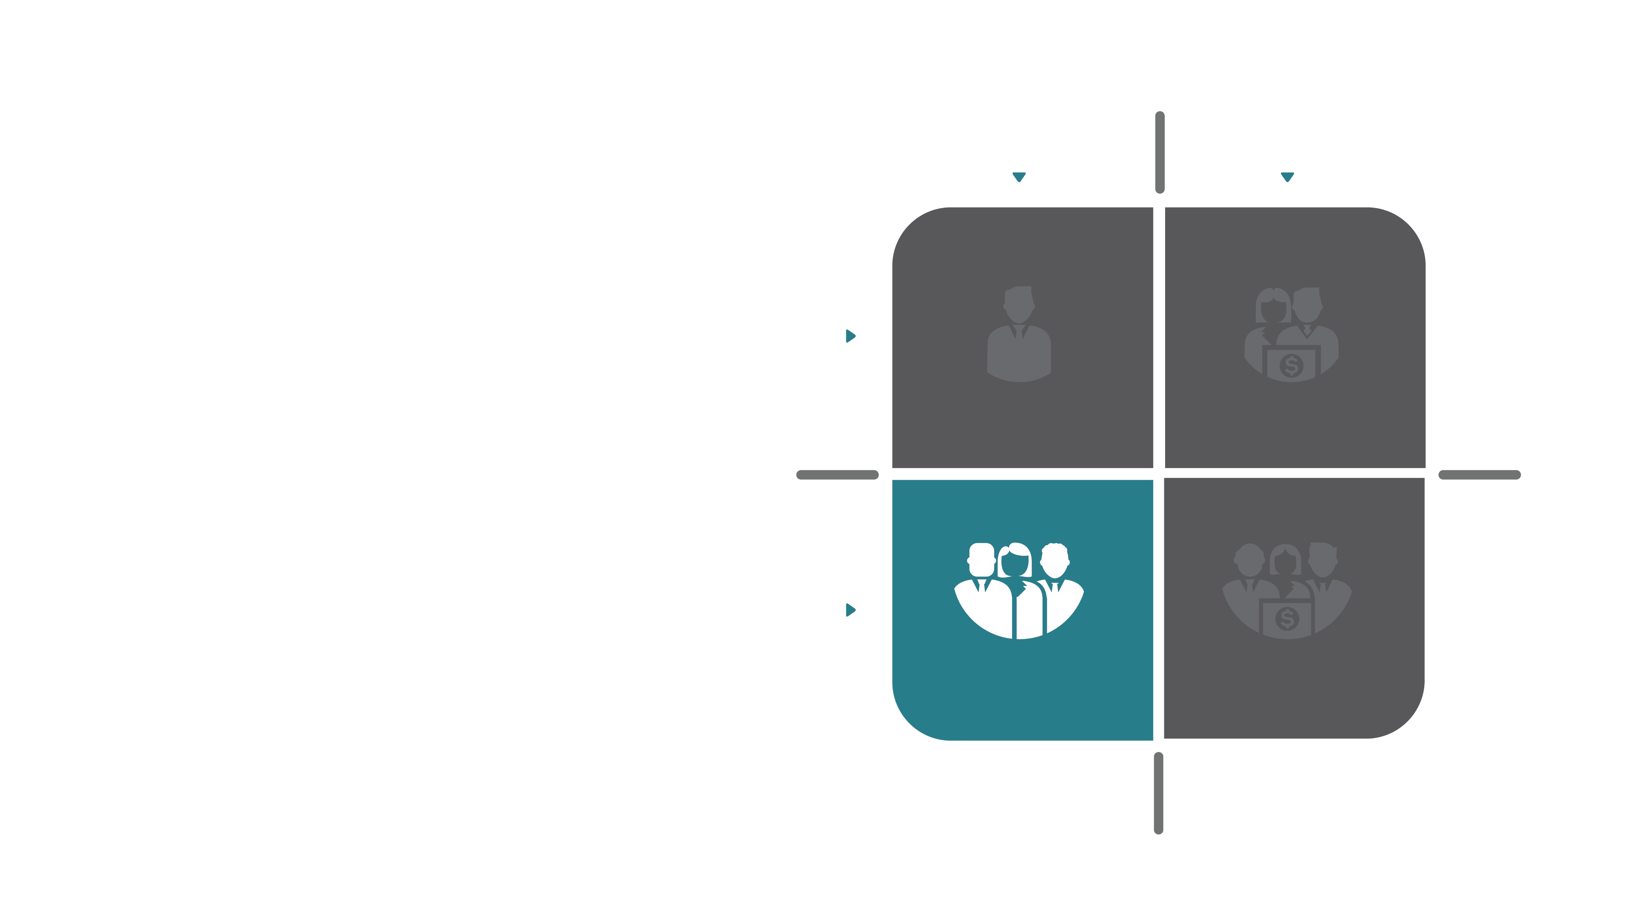
Your Ecosystem.
Internal
External
Internal Teams
Group Perspectives
Individual
“I”
“She/He”
Groups
“We”
“They”

Slide 90
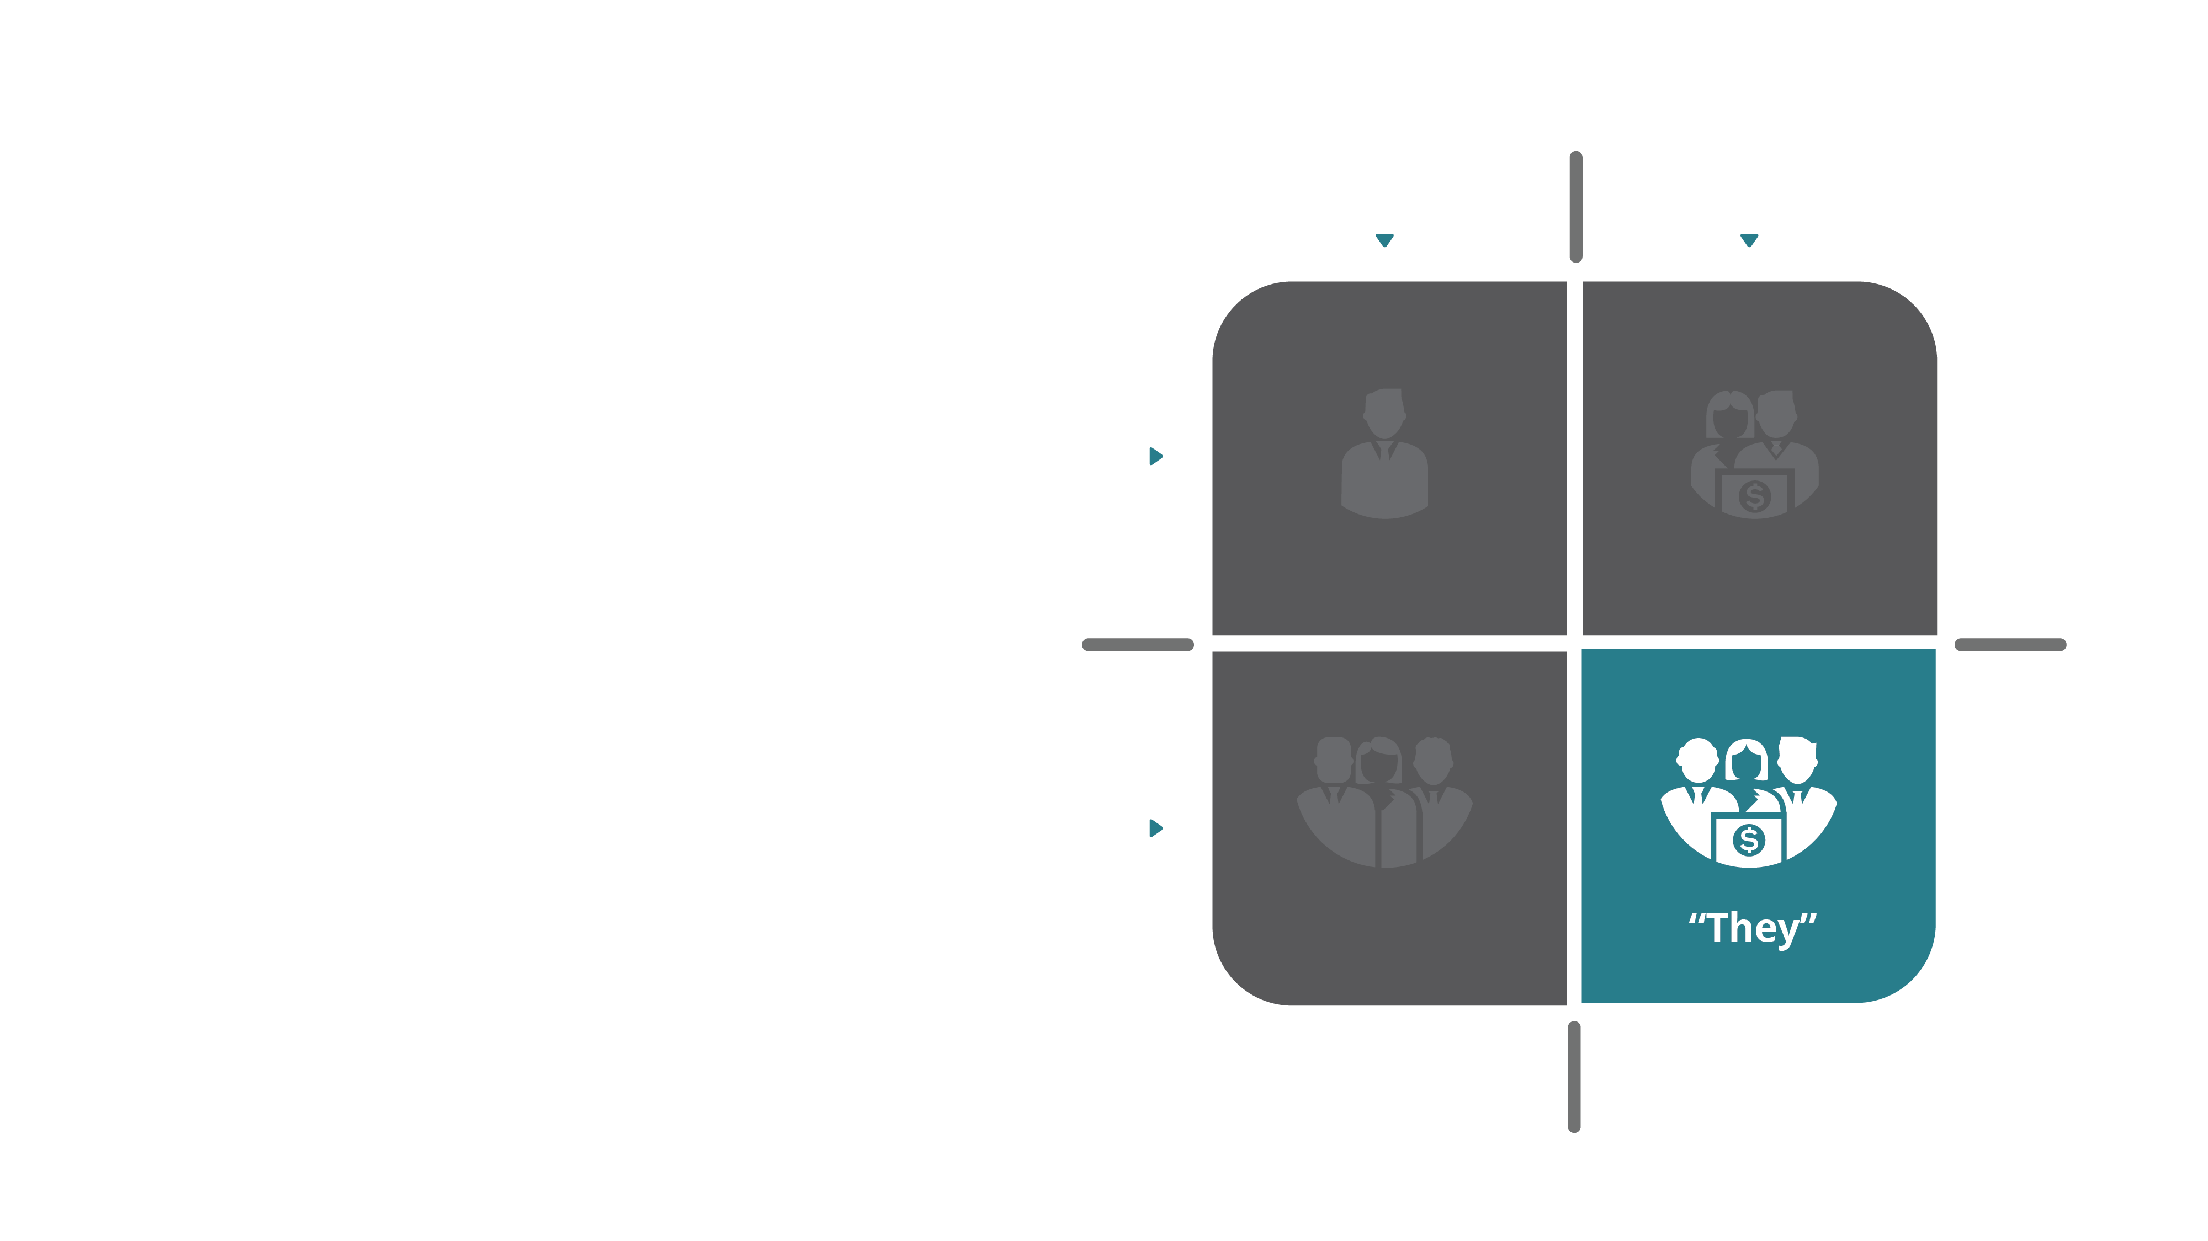
Your Ecosystem.
Internal
External
Consortiums
Customer Groups
Regulatory Entities
Individual
Groups

Slide 91
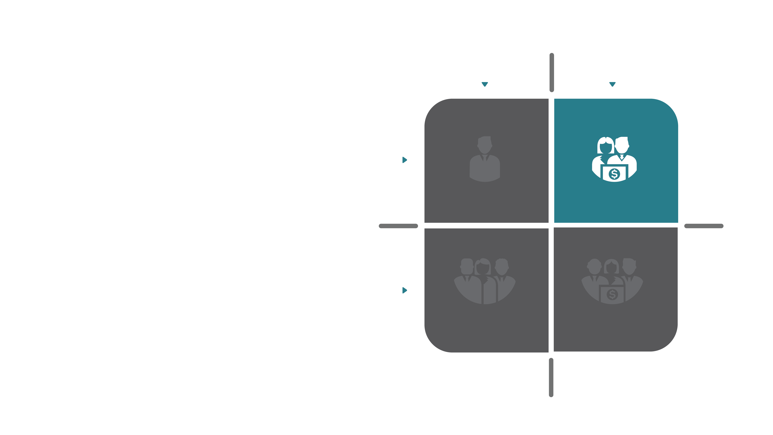
Your Ecosystem.
Internal
External
Users
Customers
Partners
Sales Channels
Individual
“She/He”
Groups
“We”
“They”

Slide 92
Core Customers.
How Can Technology
Inspire The Right People?

Slide 93
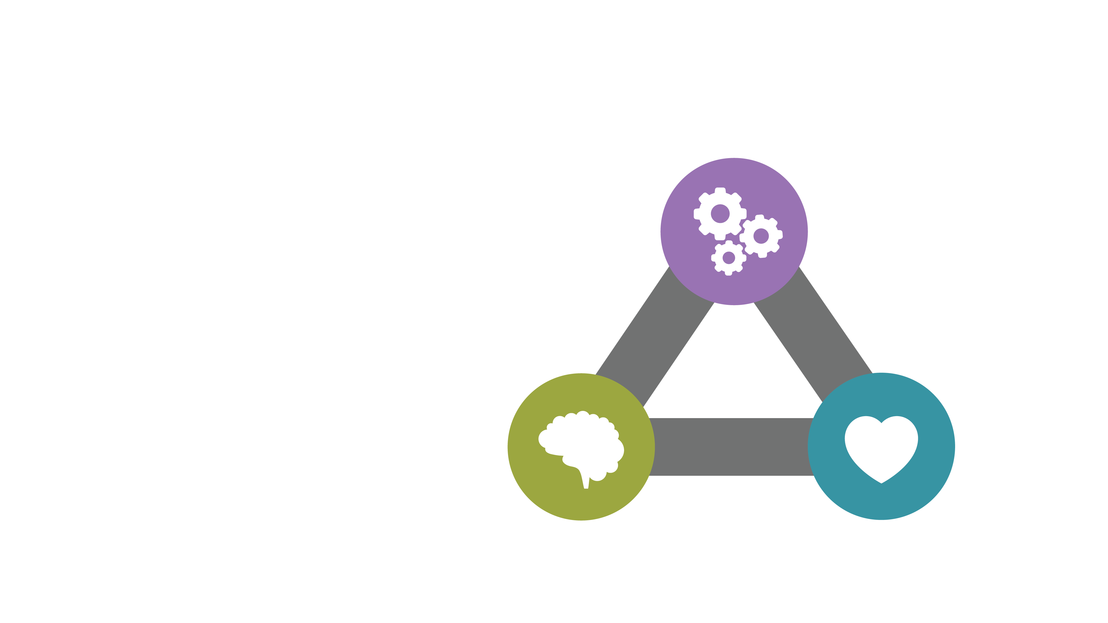
Self
Determination
Theory.
AUTONOMY
The Science of Intrinsic
Motivation.
21,406
COMPETENCE
RELATEDNESS

Slide 94
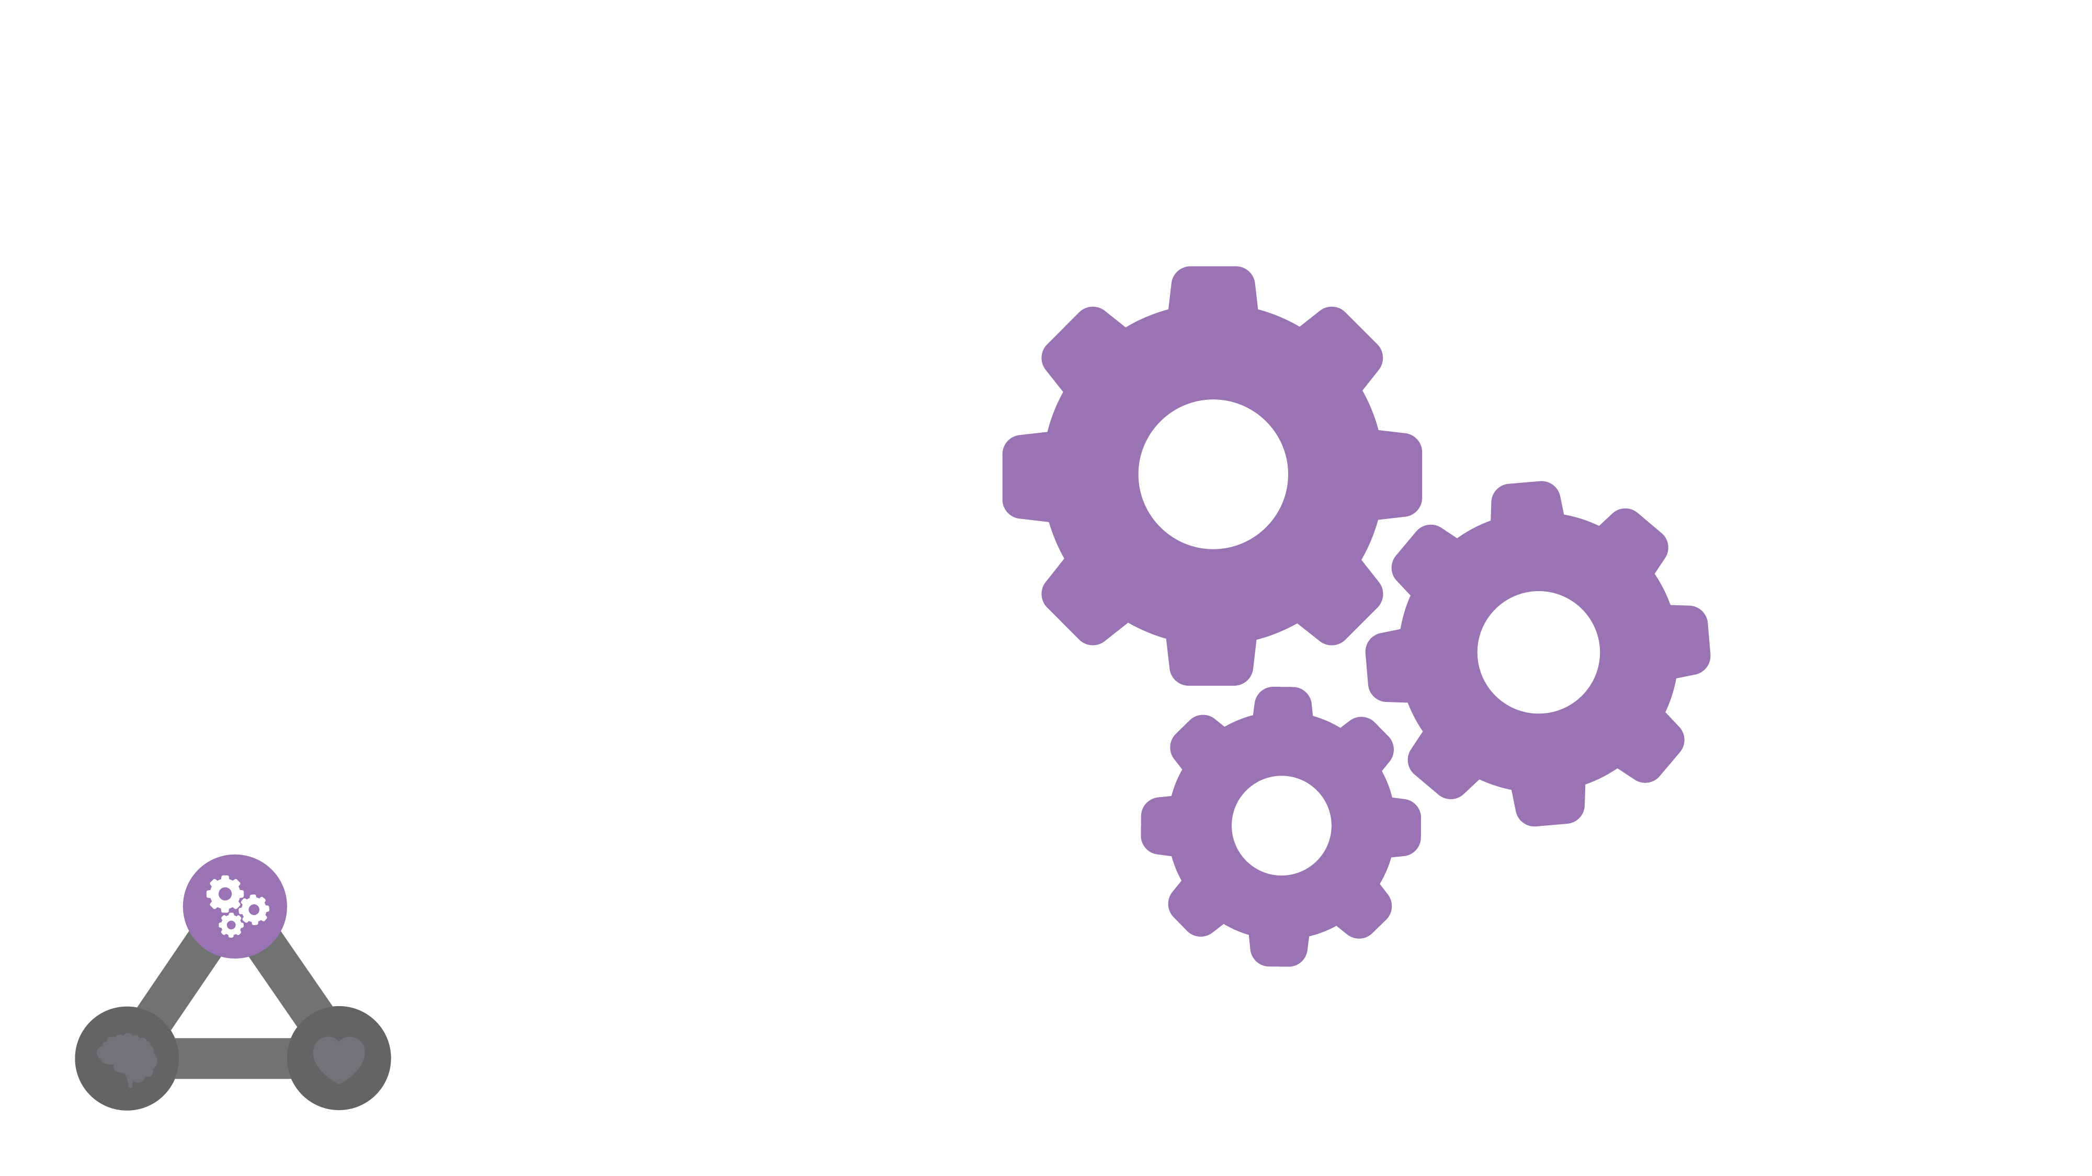
Autonomy.
The Power of Free Will

Slide 95
Watch Your Language.
“Autonomy Supportive” vs. Coercive
Lexicon of Choice

Slide 96
Be Human.
Human Language
Use Faces
Human Interactions

Slide 97
Be a Guide.
Guide vs. Drive
Pull vs. Push
Choice Architecture

Slide 98
Invest in Search.
Study Queries
Invest in Solving Search Problems

Slide 99
Allow Easy Egress
The Real World
Recovery Mindset
Easy Egress and Recovery

Slide 100
Self
Determination
Theory.
AUTONOMY
The Science of Intrinsic
Motivation.
21,406
COMPETENCE
RELATEDNESS

Slide 101
Relatedness.
Emotional Intelligence in Action
Connection to Purpose

Slide 102
Empathy Map.
THINK & FEEL
How Your Customers
Feel Matters
HEAR
SEE
SAY & DO
PAIN
GAIN

Slide 103
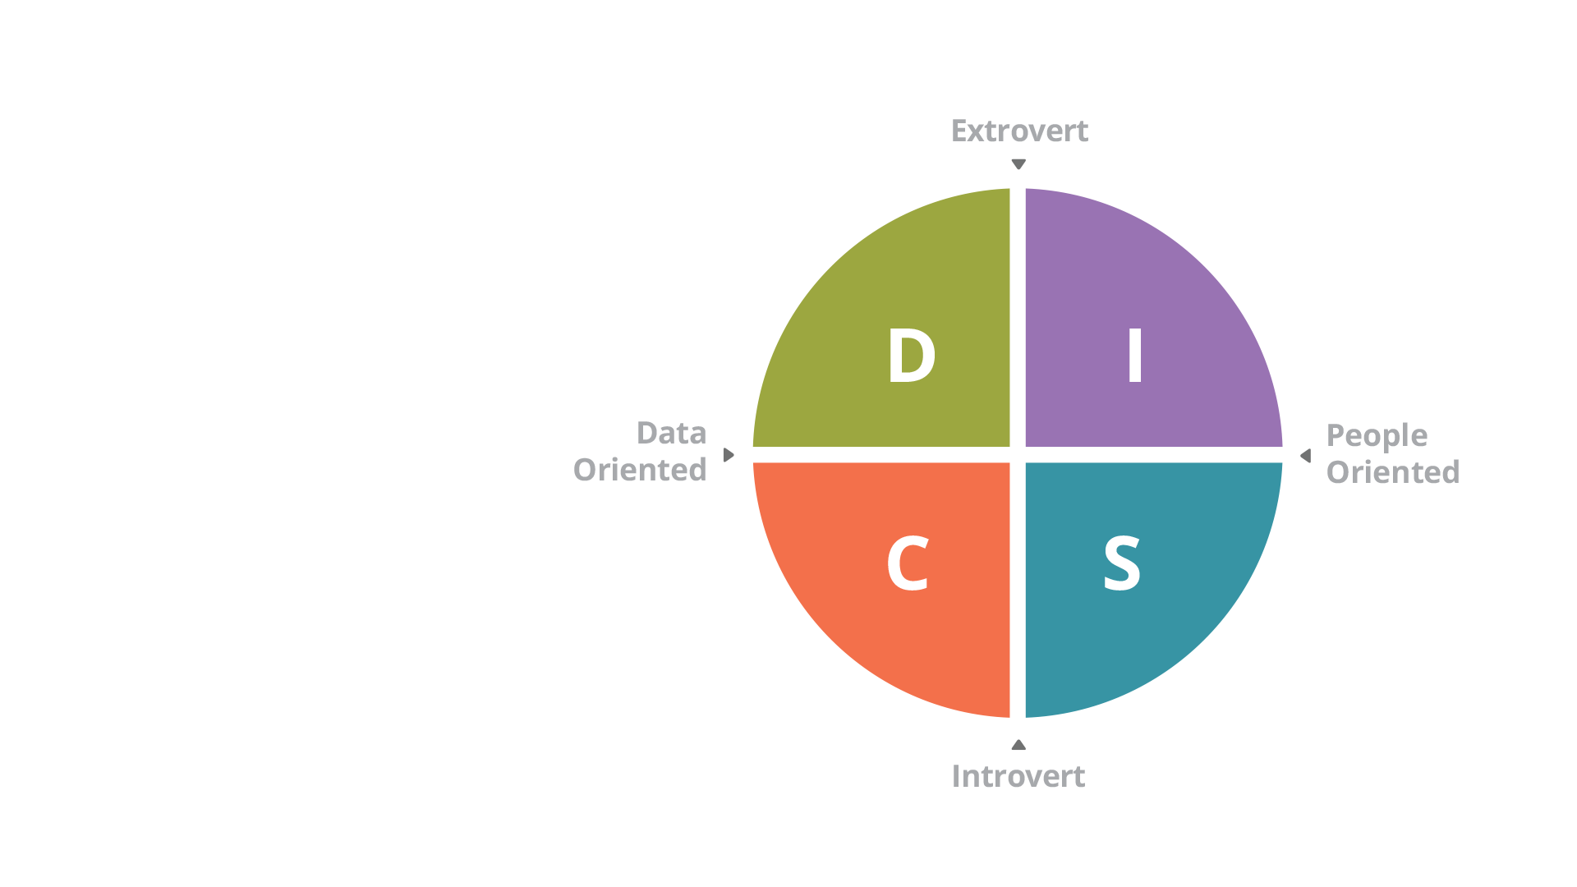
D.I.S.C.
Personalization Matters

Slide 104
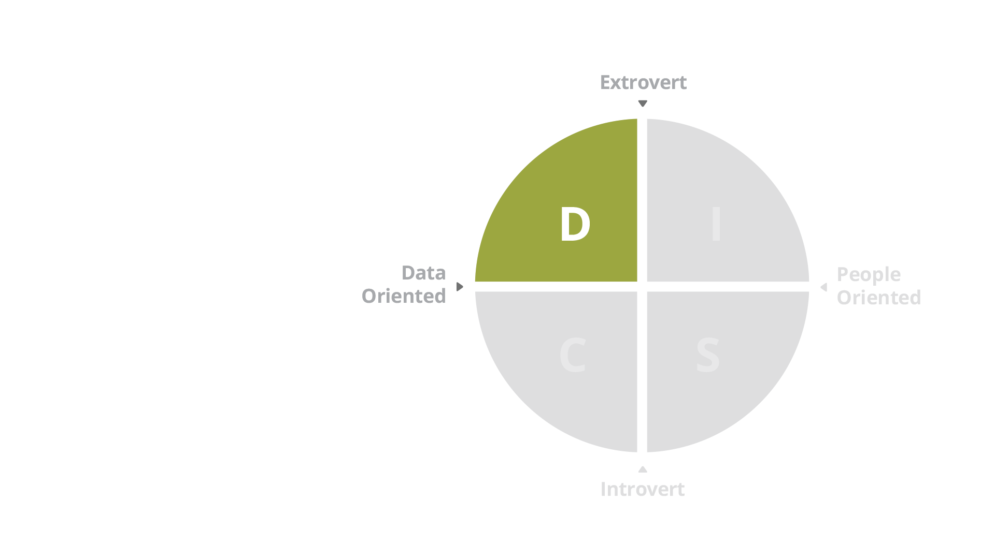
D.I.S.C.
Drivers
Snap Decisions
“Take The Hill” Leaders
Low Empathy

Slide 105
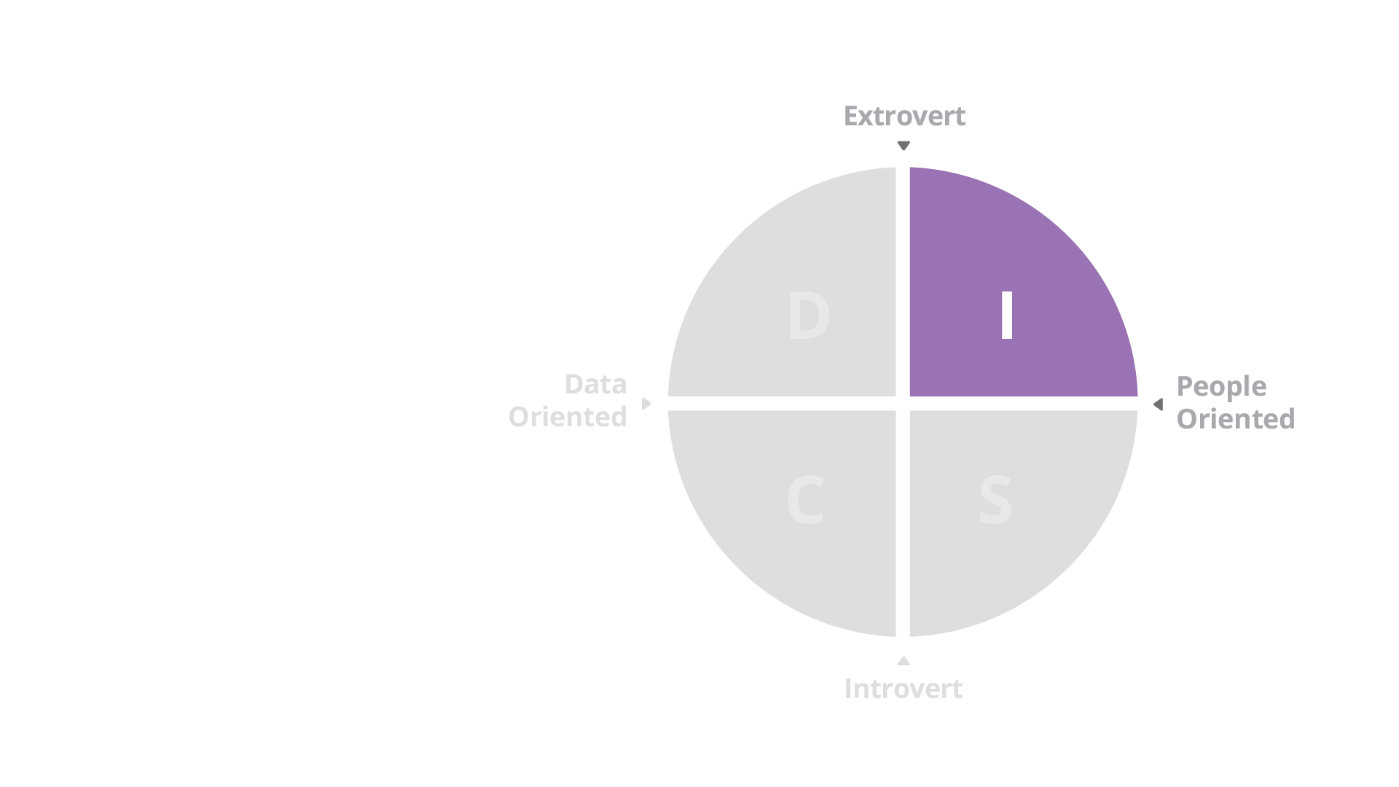
D.I.S.C.
Influencers
Gut Decisions
Visionary
Distracted

Slide 106
D.I.S.C.
Supportives
Decisions by Committee
Consensus Leaders
Slow and Steady

Slide 107
D.I.S.C.
Compliants
Decisions by Data
Logical
Analytical

Slide 108
Maslow.
The Hierarchy of Needs
SELF ACTUALIZATION
ESTEEM
BELONGING
SAFETY
PHYSIOLOGICAL

Slide 109
Physiological.
“I can function”
“I can access”
SELF ACTUALIZATION
ESTEEM
BELONGING
SAFETY
PHYSIOLOGICAL

Slide 110
Safety.
“I feel safe”
“I am comfortable”
“I am in control”
SELF ACTUALIZATION
ESTEEM
BELONGING
SAFETY
PHYSIOLOGICAL

Slide 111
Belonging.
“I am in the right place”
“I belong”
“I relate”
SELF ACTUALIZATION
ESTEEM
BELONGING
SAFETY
PHYSIOLOGICAL

Slide 112
Esteem.
"I compete”
“I succeed”
“I achieve”
SELF ACTUALIZATION
ESTEEM
BELONGING
SAFETY
PHYSIOLOGICAL

Slide 113
Self Actualization.
“I am a part of something bigger”
“I contribute”
SELF ACTUALIZATION
ESTEEM
BELONGING
SAFETY
PHYSIOLOGICAL

Slide 114
Social Honeycomb.
Social Interaction Map

Slide 115
Social Honeycomb.
Not all social interactions
are equal

Slide 116
Personas.
Know your users: Continuously “Groom” Your Personas like you would your requirements

Slide 117
Self
Determination
Theory.
AUTONOMY
The Science of Intrinsic
Motivation.
21,406
COMPETENCE
RELATEDNESS

Slide 118
Self
Determination
Theory.
AUTONOMY
COMPETENCE
RELATEDNESS

Slide 119
Self
Determination
Theory.
AUTONOMY
E’s of Inspiration.
COMPETENCE
RELATEDNESS

Slide 120
Empowerment.
Competence + Autonomy
(Missing Relatedness)
AUTONOMY
COMPETENCE
RELATEDNESS

Slide 121
Engagement.
Autonomy + Relatedness
(Missing Competence)
AUTONOMY
RELATEDNESS
COMPETENCE

Slide 122
Education
Competence + Relatedness
(Missing Autonomy)
AUTONOMY
COMPETENCE
RELATEDNESS

Slide 123
Self
Determination
Theory.
AUTONOMY
E’s of Inspiration
COMPETENCE
RELATEDNESS

Slide 124
Self
Determination
Theory.
AUTONOMY
The Science of Intrinsic
Motivation.
21,406
COMPETENCE
RELATEDNESS

Slide 125
Competence.
Knowing vs. Thinking

Slide 126
Persona Competence Scale.
What are we working with
TECH
SAVVY
DOMAIN
SAVVY

Slide 127
D.I.K.W.
Where Wisdom
Comes From
DATA
INFORMATION
KNOWLEDGE
WISDOM

Slide 128
Competence
Matrix.
Incompetence
Competence
The Path to Mastery
Conscious
Unconscious

Slide 129
Unconscious
Incompetence.
Incompetence
Competence
You don’t know what
you don’t know
Conscious
Unconscious

Slide 130
Conscious
Incompetence.
Incompetence
Competence
You know what
you don’t know
Conscious
Unconscious

Slide 131
Conscious
Competence.
Incompetence
Competence
You know and are capable
Conscious
Unconscious

Slide 132
Unconscious
Competence.
Incompetence
Competence
You’ve mastered the task
Conscious
Unconscious

Slide 133
Competence
Matrix.
Incompetence
Competence
The Path to Mastery
Conscious
Apprentice
Journeyman
Unconscious
Novice
Master

Slide 134
The Competence Continuum.
The Path to Mastery

Slide 135
The Competence Continuum.

Slide 136
The Competence Continuum.

Slide 137
Conversations.
A Four Quadrant Model
Guru
Culture
Competence
In Community
Status
Quo
Chaos &
Gossip

Slide 138
Status Quo
No Changes
in Competence or Culture
Guru
Culture
Competence
In Community
Status
Quo
Chaos &
Gossip

Slide 139
Guru Culture
Small number of experts
Limited value
Silos
Guru
Culture
Competence
In Community
Status
Quo
Chaos &
Gossip

Slide 140
Chaos
Chaotic Conversations
Gossip
Confusion
Guru
Culture
Competence
In Community
Status
Quo
Chaos &
Gossip

Slide 141
Competence in
Community
It’s all about conversations
Guru
Culture
Competence
In Community
Status
Quo
Chaos &
Gossip

Slide 142
The Black
Jack Effect.
21 Interactions
To Form a Habit

Slide 143
Flow.
The Comfort Zone.

Slide 144
Flow.
The Comfort Zone.

Slide 145
Flow.
The Comfort Zone.

Slide 146
Flow.
The Comfort Zone.

Slide 147
Flow.
Find The Reasons

Slide 148
Flow.
Find The Reasons
WORK ON COMPLEXITY
- Simplify
- Build Competence
- Reduce Effort

Slide 149
Flow.
Find The Reasons
WORK ON MOTIVATION
- Start with “Why”
- Relatedness
- Gamify

Slide 150
Motivation Mechanics.

Slide 151
Motivation Mechanics
USER
VALUE
MOTIVATION
MECHANICS
BUSINESS
VALUE

Slide 152
Motivation Mechanics
USER
VALUE
MOTIVATION
MECHANICS
BUSINESS
VALUE

Slide 153
Engagement Loops.
Engineer the Experience.

Slide 154
Iceberg Principle.
USABLE
FUNCTIONAL
RISK MANAGED
EFFICIENTLY
BUILT
FUTURE READY
PERFORMANT
SUPPORTABLE

Slide 155
Risk Managed.
- Secure
- Compliant
- Licensed
- Auditable

Slide 156
Efficiently Built.
- Standardized Toolsets
- Best Coding Practices
- Source Controlled

Slide 157
Future Ready.
- Reusable
- Modular
- Debt Managed
- Documented

Slide 158
Performant
- Responsive
- Scalable
- Reliable

Slide 159
Supportable.
- Serviceable
- Testable
- Traceable
- Maintainable
- Deployable

Slide 160
The Balancing Act.
Your Team Has To Choose
Compliant
RISK MANAGED
Secure
EFFICIENTLY
BUILT
Source Managed
Reusable
Modular
FUTURE READY
Extensible
Scalable
PERFORMANT
Reliable
Serviceable
SUPPORTABLE
Testable

Slide 161
Dimensions
of Quality.
FUNCTIONAL
EFFICIENTLY
BUILT
Every Product has
a Risk Profile
SUPPORTABLE
PERFORMANT
FUTURE READY
USABLE
RISK
MANAGED

Slide 162
Dimensions
of Quality.
FUNCTIONAL
EFFICIENTLY
BUILT
Every Product’s Risk
Profile is Different
SUPPORTABLE
PERFORMANT
FUTURE READY
USABLE
RISK
MANAGED

Slide 163
Experience Maturity.
Current State.

Slide 164
Experience Maturity.
Current State.

Slide 165
Experience Maturity.
Current State.

Slide 166
Behavioral Economics.
Predictable Irrationality.

Slide 167
What We Know.
Our Collective Wisdom.

Slide 168
What We Know
That We Don’t
Know.
We’re just getting
started.

Slide 169
What We Don’t Know
We Don’t Know.
Our Known Unknown.

Slide 170
Momentum.
Momentum Requires Discipline

Slide 171
Vision.
Clarity of Customer, Product Mission and What the Customer Values

Slide 172
Motivation.
Aligned, Unified and Energized

Slide 173
Roadmap.
Once the Roadmap is Agreed Upon, the Product is Unstoppable

Slide 174
Capability.
Skills, Tools, Knowledge and Capital

Slide 175
Momentum.
Momentum Requires Discipline

Slide 176
Continuous Innovation.
Strategy Should
Continuously Evolve

Slide 177
Micro-strategy.
Continuous Innovation

Slide 178
Questions.
INSPIRE
TOUCH
MOVE

Slide 179
References.
Standing Upon The Shoulders of Giants.
Golden Circle: Attributed to Simon Sinek; Start With Why(2011)
https://www.startwithwhy.com/
Hoshin Star: Attributed to: Masaaki Imai; Kaizen (1986)
https://www.amazon.com/Kaizen-Key-Japans-Competitive-Success/dp/0071126473https://www.amazon.com/Maslow-Management-H/dp/0471247804
SWOT: Attributed to: Marion Dosher, Dr Otis Benepe, Albert Humphrey, Robert Stewart, Birger Lie Morrison, M. (2006) SWOT Analysis, https://rapidbi.com/SWOTanalysis
Ecosystem Map: Adapted from Ken Wilber; Theory of Everything (2001)
https://www.amazon.com/Theory-Everything-Integral-Business-Spirituality/dp/1570628556/
Self Determination Theory: Adapted from Edward Deci and Richard Ryan’s work:
http://selfdeterminationtheory.org/
EmpathyMap: https://dschool.stanford.edu/groups/k12/wiki/3d994/empathy_map.html
DISC: Adapted from Molton Marsen’s work: https://www.amazon.com/Emotions-Normal-William-Moulton-Marston/dp/1406701165
Maslow’s Heirarchy of Needs: Adapted from Abraham Maslow’s work:
https://www.amazon.com/Maslow-Management-H/dp/0471247804

Slide 180
References.
Standing Upon The Shoulders of Giants.
Social Honeycomb Attributed to: Jan H. Kietzmann *, Kristopher Hermkens, Ian P. McCarthy, Bruno S. Silvestre http://beedie.sfu.ca/files/PDF/research/McCarthy_Papers/2011_Social_Media_BH.pdf
Johari Window (Knowns to Unknown Unknowns): Attributed to Joseph Luft and Harrington Ingham (Jo + Hari): https://en.wikipedia.org/wiki/Johari_window
DIKW: https://en.wikipedia.org/wiki/DIKW_pyramid
Conscious Competence Model Attributed to Abraham Maslow, but unverified: https://en.wikipedia.org/wiki/Four_stages_of_competence
21 Days: Adapted from Maxwell Maltz: https://www.amazon.com/Psycho-Cybernetics-Maxwell-Maltz/dp/0671221507
Flow: Attributed to Mihaly Csikszentmihalyi: https://www.amazon.com/Flow-Psychology-Experience-Perennial-Classics/dp/0061339202
Activity Curve: Attributed to B.J. Fogg. http://www.behaviormodel.org/
Engagement Loops: Attributed to Eric Ries http://www.startuplessonslearned.com/2008/12/engagement-loops-beyond-viral.html

